Slide 1

Dendrogram-based Algorithm Weighted Graphs Flooding Algorithm – Implementation - Parallelization
Claude Tadonki and Fernand Meyer
Centre de Recherche en Informatique
Centre de Morphologie Mathématique
Mines ParisTech
TIMC Project
Arnaud de La Fortelle et Fabien Moutarde (CAOR)
Matthieu Faessel, Serge Koudoro, Beatriz Marcotegui et Fernand Meyer (CMM)
Claude Tadonki, Laurent Daverio et Francois Irigoin (CRI)
Séminaire au Centre de Morphologie Mathématique (Mines ParisTech)
Fontainebleau – January 27, 2014

Slide 2
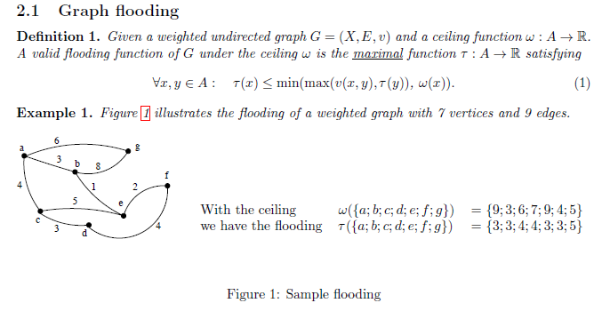

The problem
We study a decomposition algorithm based on the structure of dendrogram
Dijkstra algorithm is greedy
Berge algorithm is dynamical programming
Claude Tadonki (CRI)
Fernand Meyer (CMM)
Dendrogram-based algorithm for graph flooding under ceiling constraints
TIMC project – Mines ParisTech (CAOR/CMM/CRI)

Slide 3

The whole algorithm
Build the dendrogram (this is a n-ary tree, we have considered a binary correspondance)
Distribute the ceiling values of the vertices among the subdendrograms (this is a mintree)
Flood the dendrogram from its leaves until we get the flooding levels of all vertices.
Theses are the main steps of the dendrogram-based algorithm.
Dendrogram based algorithm has several strengths
- can be used to generate information from a local input (flooding from a single vertex)
- exposes parallelism (when dismantling subdendrograms)
- several floodings of the same graph can be performed using its dendrogram structure. This aspect is
particularly interesting because flooding from the dendrogram is very fast compared to the cost of
constructing the dendrogram structure itself.
- is potentially efficient because key information are handled at the level of the sets (rather than individual vertices).
Other algorithms are global, so will always process with and for the whole graph,
Live demo !!!
Claude Tadonki (CRI)
Fernand Meyer (CMM)
Dendrogram-based algorithm for graph flooding under ceiling constraints
TIMC project – Mines ParisTech (CAOR/CMM/CRI)

Slide 4

Constructing the dendrogram
D ← Ø
S ← {all edges (u, v, w) of the graph}
while(S ≠ Ø ){
//we select the edge with minimum cost
(u, v) ← min_w(S); //we can sort the list of edges and select on top
//we remove that edge from S
S ← S – {(u, v)};
//we get the id the of the root subdendrogram containing u
d1 ← id_root_subdendrogram(u);
//we get the id the of the root subdendrogram containing v
d2 ← id_root_subdendrogram(v);
//we create a singleton subdendrogram if no one was so far created
if(d1 == NULL) d1 ← dendrogram_singleton({u});
if(d2 == NULL) d2 ← dendrogram_singleton({v});
//we merge the two subdendrogam d1 and d2 to form a new one (parent)
if(d1 ≠ d2)
D ← D ∪ d;
d ← dendrogram_merge(d1, d2);
endif
}
Technical remarks
dendrogram_singleton({u}) creates a subdendrogram with singleton {u}
If u and v belong to an existing subdendrogram, then we avoid recreating it
id_root_subdendrogram(u) is obtained by climbing from
dendrogram_singleton({u}) to the maximal subdendrogram following the
parent (successor) relation.
This function is the most time consuming of the construction. Its global impact depends on the depth or height of the dendrogram tree.
Claude Tadonki (CRI)
Fernand Meyer (CMM)
Dendrogram-based algorithm for graph flooding under ceiling constraints
TIMC project – Mines ParisTech (CAOR/CMM/CRI)

Slide 5
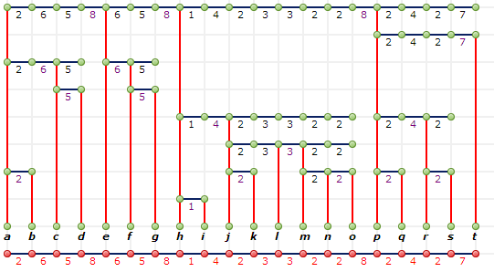
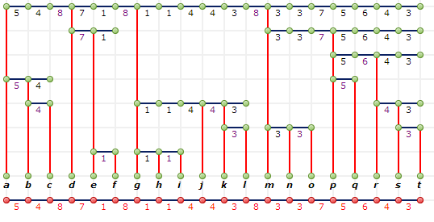


Properties of the dendrogram that impact on performances
Dendrogram constructed from a linear graph
Depth = 7
(b) Dendrogram constructed from a linear graph
Depth = 8
Technical remarks
In (a), getting the root from node s will cost 1, 2, 3, 4, and 5 steps respectively.
In (b), getting the root from node s will cost 1, 2, 3, and 4 steps respectively.
Going from a given leave to the root of its containg sub-dendrogram is so
repeated that it costs. We should move from the previous root (so, store the roots!).
and (b) are linear graphs, so each edge leads to a subdendrogram.
This is not the case with any graph, like those containing cycles.
For each subdendrogram, we keep the outgoing edge with minimum cost.
Having the list of edges sorted makes this easy, since the minimum outgoing
edge is exactly the one connecting the subdendrogram to its parent.
Claude Tadonki (CRI)
Fernand Meyer (CMM)
Dendrogram-based algorithm for graph flooding under ceiling constraints
TIMC project – Mines ParisTech (CAOR/CMM/CRI)

Slide 6

Flooding from a leaf of the dendrogram and the complete process
//we get the leaf subdendrogram from which twe start the flooding process
d ← leaf_subdendrogram(x)
//we go up while the ceiling is still greather that the diameter
while((!is_root(d))&&(ceil(d) > diam(d))) d ← pred(d);
//we have reached a root and still get a ceiling greather that the diameter
//we set the definitive flooding values of this subdendrogram to ceil(d)
if(ceil(d) > diam(d)) set_flooding_level(d, ceil(d));
else dismantle_ancestors(d, ceil(d));
flood_from_vertex (x)
Technical remarks
The dismantling process breaks the (sub)dendrogram into independent root subdendrograms.
Newly created root subdendrograms during the dismantling process are put into a FIFO queue.
Each root subdendrogram is flooded through its vertex with the minimum id (value into the FIFO).
The complete flooding process is achieved using the following loop
//the last subdendrogram we have created is maximal, thus a root
FIFO_root_to_explore[0] ← lastly_created_subdendrogram
nb_root_to_explore ← 1
for(i = 0; i < nb_root_to_explore; i++)
flood_from_vertex(get_vertex_with_min_id(FIFO_root_to_explore[i]);
The FIFO will be populated during the dismantling processes and
nb_root_to_explore will be incremented accordingly.
In which order should we explore
the sub-dendrograms ? Does this
impact on the decomposition ? Perf ?
Claude Tadonki (CRI)
Fernand Meyer (CMM)
Dendrogram-based algorithm for graph flooding under ceiling constraints
TIMC project – Mines ParisTech (CAOR/CMM/CRI)

Slide 7
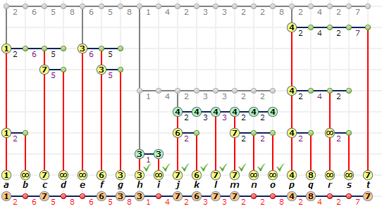
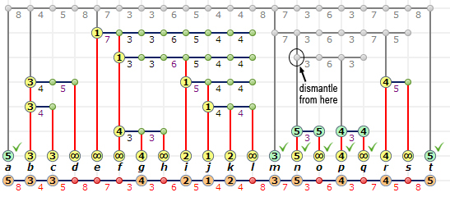
The dismantling process
while(!is_root(d)){
for(i = 0; i< nb_children(d); i++){
e ← get_child_subdendrogram(d, i);
cut_relationship(e, d); //e is no longer a child of d (dismantling)
//the min_out_edge is set to max(min_out_edge, ceil(d)) VERY IMPORTANT!!!
if(min_out_edge(d) < ceil(d)) set_min_out_edge(e, ceil(d));
if(ceil(e) > min_out_edge(e)) set_ceil(e, min_out_edge(e)); //update of ceil(e)
if(ceil(e) > diam(e)) set_flooding_level(e, ceil(e));
else{FIFO_root_to_explore[nb_root_to_explore] = e; nb_root_to_explore++;}
}
d ← pred(d);
}
dismantling_ancestors(d)
Technical remarks
The minimum outgoing edge is compared to the ceiling of the parent, and we take the maximum.
The dismantling process can either terminate the flooding of a subdendrogram or make it independent.
Claude Tadonki (CRI)
Fernand Meyer (CMM)
Dendrogram-based algorithm for graph flooding under ceiling constraints
TIMC project – Mines ParisTech (CAOR/CMM/CRI)

Slide 8
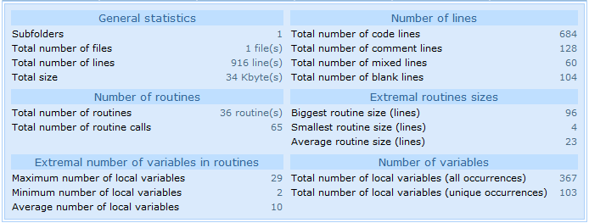
Main data structures and quantitative overview of the program
typedef struct
{
int edge_id; // the id of the edge used to cerate this dendrogram (by merging)
char is_leaf_left; // tells if the left child is a (sub)dendrogram or vertex
char is_leaf_right; // tells if the right child is a (sub)dendrogram or vertex
double diam; // diameter of the (sub)dendrogram
double min_outedge; // the outgoing edge with the minimum cost
int size; // number of vertices of the support of this (sub)dendrogram
double ceil; // global ceiling of the dendrogram (obtained when propagating the input ceiling values)
double flood; // flooding value of the dendrogram (TO BE COMPUTED)
int smallest_vertex; // we keep the id of the vertex with the smallest ceiling
int pred; // the predecessor of this (sub)dendrogram (its parent in the hierarchical structure)
int child_left; // a dendrogram is obtained by fusing two subdendrograms (left, right)
int child_right; // right child
} dendro;
typedef struct
{
int nb_nodes;
int nb_edges;
int max_degree;
double *weight; // weight of the vertices (if any)
int *neighbors; // neighborhood of the nodes (array of size nb_nodes*max_degree)
double *values; // values in the edges (array of size nb_nodes*max_degree)
} graph;
Claude Tadonki (CRI)
Fernand Meyer (CMM)
Dendrogram-based algorithm for graph flooding under ceiling constraints
TIMC project – Mines ParisTech (CAOR/CMM/CRI)

Slide 9
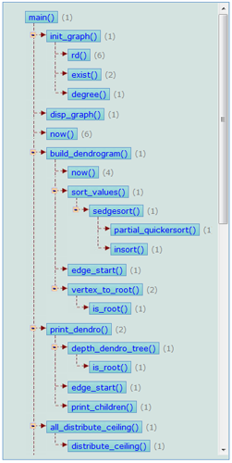
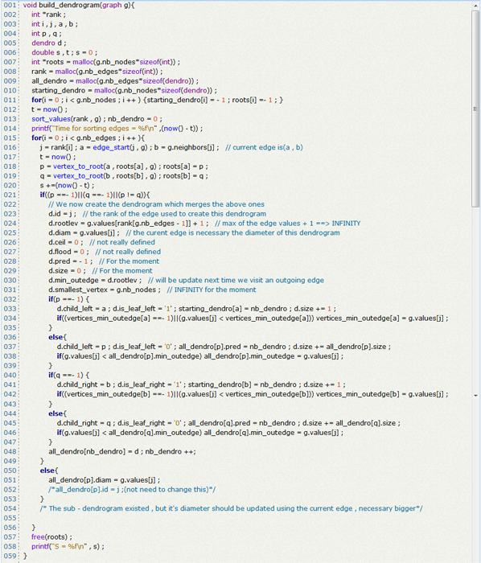
Dependences graph and sample code (building the dendrogram)
Claude Tadonki (CRI)
Fernand Meyer (CMM)
Dendrogram-based algorithm for graph flooding under ceiling constraints
TIMC project – Mines ParisTech (CAOR/CMM/CRI)

Slide 10
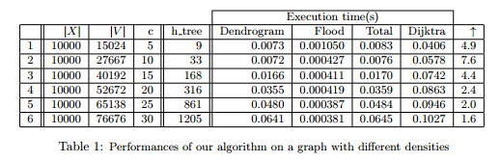
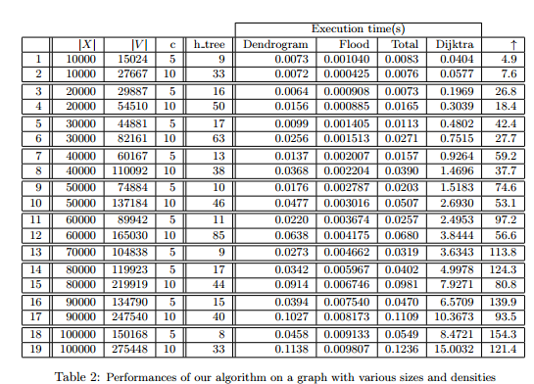
Performance on some random graphs (timings are in seconds)
The height of the dendrogram is moderate
Building the dendrogram predominates
We outperform Dijkstra by factor > 2
The height of the dendrogram is
more related to the density
Could we eliminate
inoffensive edges.
The flooding step is noticeably
fast (10% of the overall time)
We significantly outperform Dijkstra
Claude Tadonki (CRI)
Fernand Meyer (CMM)
Dendrogram-based algorithm for graph flooding under ceiling constraints
TIMC project – Mines ParisTech (CAOR/CMM/CRI)

Slide 11
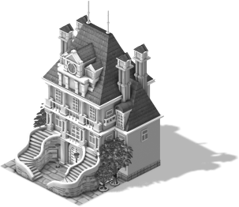



Performance on an image neighborhoods graph (Fontainebleau Palace)
Neighborhood graph
generated by morph-m
Flooding values computed by the
dendrogram-based algorithm
Number of nodes: 24 532
Number of edges: 96 138
Constructing the dendrogram: 1.737 s
Flooding process: 0.002 s
Whole algorithm: 1.739 s
Basic Dijsktra algorithm: 59.042 s
Claude Tadonki (CRI)
Fernand Meyer (CMM)
Dendrogram-based algorithm for graph flooding under ceiling constraints
TIMC project – Mines ParisTech (CAOR/CMM/CRI)

Slide 12
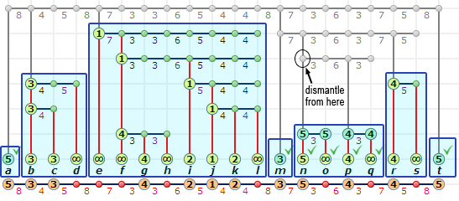

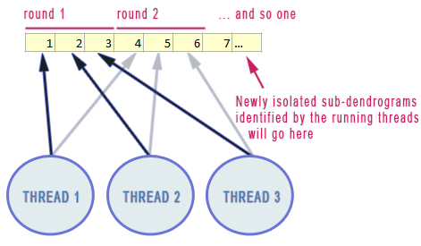

Parallelization (shared memory - pthreads)
Dismantling isolates independent subdendrograms
which can be explored in parallel
The flooding step can thus be parallelized
Care about threads creation overhead
Contend the effect of unbalanced load
We consider a multithread implementation using pthread
We create our threads once and each iterates on available subdendrograms isolated during dismantling
The threads get their exploration tasks (subdendrograms) from a common pool in a round robbing way.
Claude Tadonki (CRI)
Fernand Meyer (CMM)
Dendrogram-based algorithm for graph flooding under ceiling constraints
TIMC project – Mines ParisTech (CAOR/CMM/CRI)

Slide 13
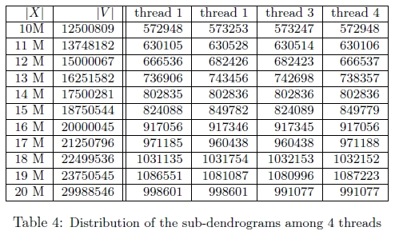
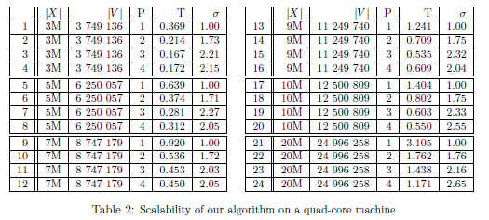
Efficiency of the parallelization
Claude Tadonki (CRI)
Fernand Meyer (CMM)
Dendrogram-based algorithm for graph flooding under ceiling constraints
TIMC project – Mines ParisTech (CAOR/CMM/CRI)

Slide 14
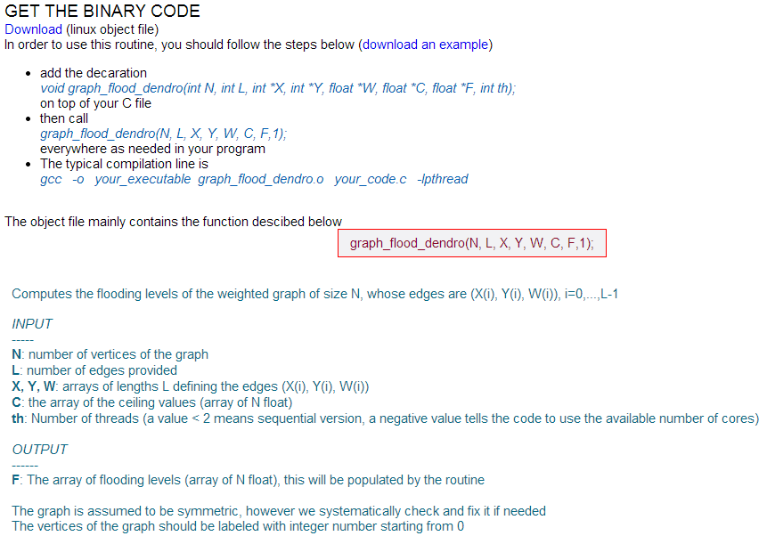
Materials
TIMC webpage http://www.cri.ensmp.fr/projet_timc.html
Simulator http://www.cri.ensmp.fr/TIMC/dendrogram/index.htm
Results & code http://www.cri.ensmp.fr/TIMC/dendrogram/flooding.htm
Report http://www.cri.ensmp.fr/classement/doc/E-329.pdf
Claude Tadonki (CRI)
Fernand Meyer (CMM)
Dendrogram-based algorithm for graph flooding under ceiling constraints
TIMC project – Mines ParisTech (CAOR/CMM/CRI)

Slide 15


Perspectives & END
Consider load balanced from the size of the subdendrograms (instead of their number)
Parallelize the construction of the dendrogram
How to get the dendrogram of a modified graph from that of the original ?
Mathematical programming appraoches
Claude Tadonki (CRI)
Fernand Meyer (CMM)
Dendrogram-based algorithm for graph flooding under ceiling constraints
TIMC project – Mines ParisTech (CAOR/CMM/CRI)

