Slide 1

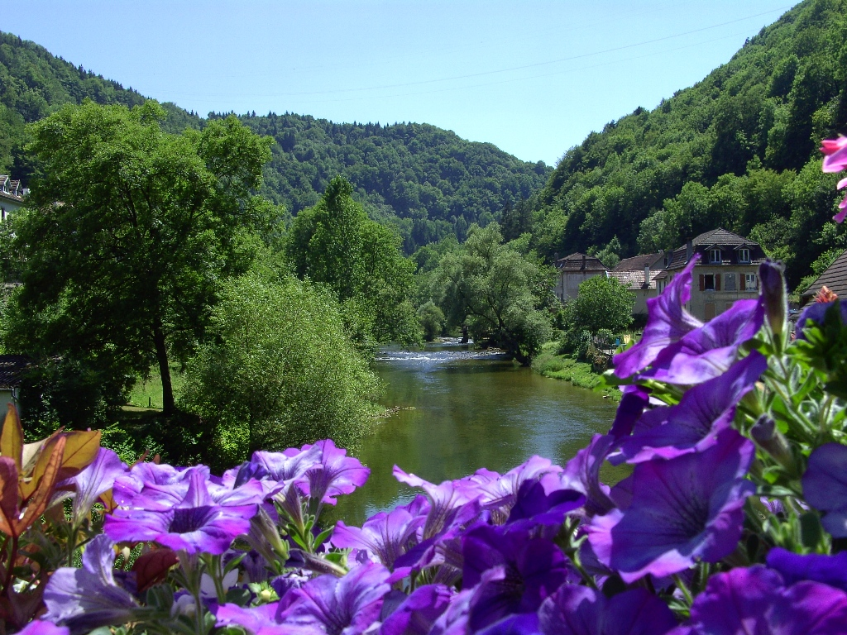
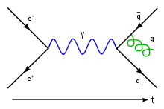
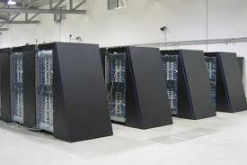
Automatic LQCD Code Generation
Claude Tadonki
Mines ParisTech – CRI (Centre de Recherche en Informatique) - Mathématiques et Systèmes
LAL (Laboratoire Accélérateur Linéaire)/IN2P3/IN2P3
Joint work with
D. Barthou, C. Eisenbeis, G. Grosdidier, M. Kruse, L. Morin, O. Pène, and K. Petrov,
PetaQCD Project
Quatrièmes Rencontres de la Communauté Française de Compilation
December 5-7, 2011
Saint-Hippolyte (France)

Slide 2
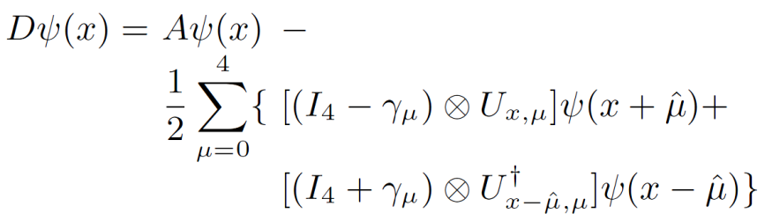
Automatic LQCD Code Generation Claude Tadonki
PetaQCD Project
Background
Quantum Chromodynamics is the theory of strong interactions, whose ambition is to explain nuclei cohesion as well as neutron and proton structure, i.e. most of the visible matter in the Universe.
The only systematic and rigorous method to solve this theory is Lattice QCD (LQCD), which can be numerically simulated on massively parallel supercomputers.
LQCD simulations are based on the Monte Carlo paradigm. The main ingredient of the computation is the resolution of a linear system based on the Dirac matrix, which is an abstract representation of the (local) Dirac operator.
The Dirac operator applied on a site x of the lattice can be expressed as follows:
The Dirac operator involves a stencil computation, which applies on a large number of sites.
Quatrièmes Rencontres de la Communauté Française de Compilation
December 5-7, 2011 , Saint-Hippolyte (France)

Slide 3
Automatic LQCD Code Generation Claude Tadonki
PetaQCD Project
Key Computation Issues
Large volume of data ( disk / memory / network )
Significant number of solvers iterations due to numerical intractability
Redundant memory accesses coming from interleaving data dependencies
Use of double precision because of accuracy need (hardware penalty)
Misaligned data (inherent to specific data structures)
Exacerbates cache misses (depending on cache size)
Becomes a serious problem when consider accelarators
Leads to « false sharing » with Shared-Memory paradigm (Posix, OpenMP)
Padding is one solution but would dramatically increase memory requirement
Memory/Computation compromise in data organization (e.g. gauge replication)
Quatrièmes Rencontres de la Communauté Française de Compilation
December 5-7, 2011 , Saint-Hippolyte (France)

Slide 4
Automatic LQCD Code Generation Claude Tadonki
PetaQCD Project
Why an Automatic Code Generation System
As the formulae could be frequently changed or adapted, a push-button system to get the corresponding code is certainly comfortable.
One application of the Dirac operator involves more than thousand floating point instructions, thus it is hard to plan low level optimization by hand.
There are different variants of the Dirac operator and several way of expression the calculation depending on the data layout.
There are different target architectures which can be considered. Thus, generating the code for each of them manually can be tedious and error-prone.
One way to seek optimal implementation is to filter from an exhaustive search over all possible (or reasonable) .
Quatrièmes Rencontres de la Communauté Française de Compilation
December 5-7, 2011 , Saint-Hippolyte (France)

Slide 5
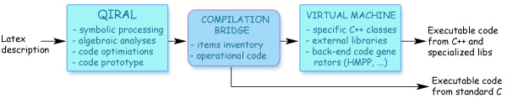
Automatic LQCD Code Generation Claude Tadonki
PetaQCD Project
How the chain is implemented
From an input file containing the formalism (formulae + algorithm), the QIRAL module generates a code prototype (called pseudo-code)
QIRAL is composed with a set of rewriting rules and predefined datatypes. The input, even written in latex, has to follow some syntaxic guidelines
Experienced user can modify the kernel of QIRAL in order for instance to enhance the rewriting rules basis or introduce new datatypes.
The output of QIRAL (the pseudo-code) is clearly a C-like prototype, which therefore needs to be retreated in order to obtain a valid (C or C++) code.
Quatrièmes Rencontres de la Communauté Française de Compilation
December 5-7, 2011 , Saint-Hippolyte (France)

Slide 6
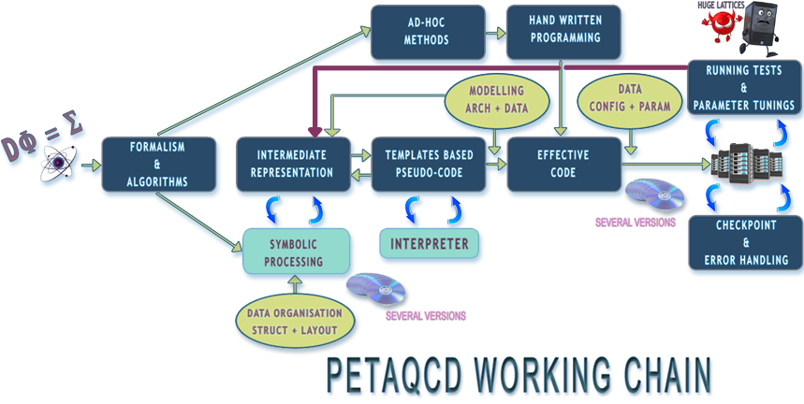
Automatic LQCD Code Generation Claude Tadonki
PetaQCD Project
The full working chain
https://www.petaqcd.org/chain/
Quatrièmes Rencontres de la Communauté Française de Compilation
December 5-7, 2011 , Saint-Hippolyte (France)

Slide 7
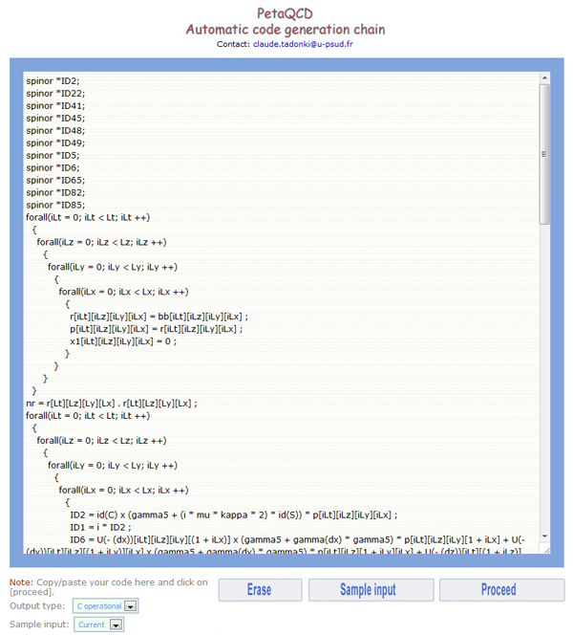
Automatic LQCD Code Generation Claude Tadonki
The pseudo-code
from Latex
Quatrièmes Rencontres de la Communauté Française de Compilation
December 5-7, 2011 , Saint-Hippolyte (France)

Slide 8
Automatic LQCD Code Generation Claude Tadonki
PetaQCD Project
The needs from the pseudo-code to a valid C code
the variables need to be explicitly declared (QIRAL declares part of the main ones)
some simplification still need to be done (id(C) x id(S) = id(C x S) and id(n)*u = u )
special statements need to be appropriately expanded (sum(d in {dx,dy,dz,dt} )
libraries calls are required for macroscopic operations (Ap[L].Ap[L]) ; (Ap[L].r[L])
specific routines should be called for special operations like (id(S) + gamma(d))*u)
4D indexation should be correctly handled/matched with its 1D correspondence
some profiling and monitoring instructions should be inserted for user convenience
I/O routines are required for user parameters and data files
data types need to be correctly captured for further semantic purposes
The last point is particularly important since it will determine the routines to be called (in standard C) or the method execute (C++ / ad-hoc polymorphism).
Quatrièmes Rencontres de la Communauté Française de Compilation
December 5-7, 2011 , Saint-Hippolyte (France)

Slide 9
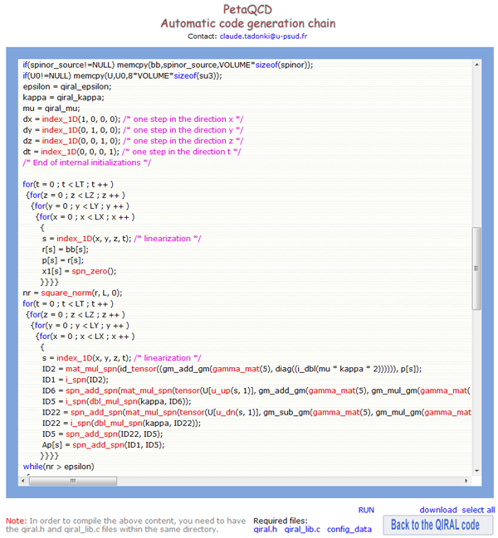
Automatic LQCD Code Generation Claude Tadonki
PetaQCD Project
The C code from the
pseudo-code
The module is based on Lex and Yacc
Its generated a valid C code
The output is associated to an
external library for special routines
A C++ output is planned, will be
associated with QDP++ or QUDA
through a specific interface
A web based interface is available
Quatrièmes Rencontres de la Communauté Française de Compilation
December 5-7, 2011 , Saint-Hippolyte (France)

Slide 10
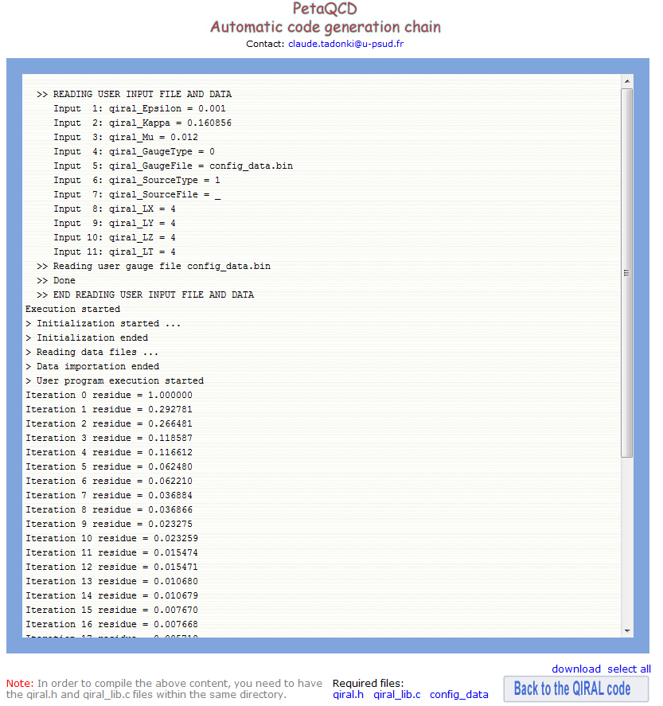
Automatic LQCD Code Generation Claude Tadonki
PetaQCD Project
Running the code
(mCR solver)
Quatrièmes Rencontres de la Communauté Française de Compilation
December 5-7, 2011 , Saint-Hippolyte (France)

Slide 11
Automatic LQCD Code Generation Claude Tadonki
PetaQCD Project
Concluding remarks and peserspecives
Try to generate the final code in one step
Insert pragmas (OpenMP, HMPP, …) for special targets or automatic parallelization
Add a complexity evaluation module (useful for automatic code optimization)
Build the global system including the searching mecanism to reach the optimal code
Generalize the framework (LQCD should not remains the main target)
Quatrièmes Rencontres de la Communauté Française de Compilation
December 5-7, 2011 , Saint-Hippolyte (France)

Slide 12
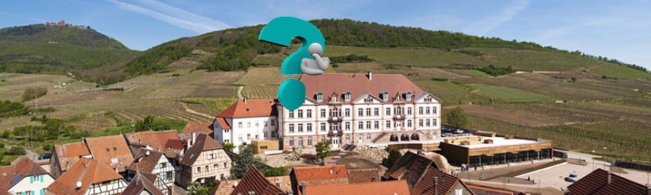

Automatic LQCD Code Generation Claude Tadonki
THANKS FOR YOUR ATTENTION
END
Quatrièmes Rencontres de la Communauté Française de Compilation
December 5-7, 2011 , Saint-Hippolyte (France)

