Slide 1
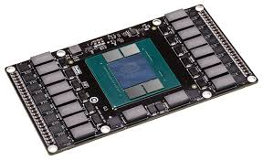
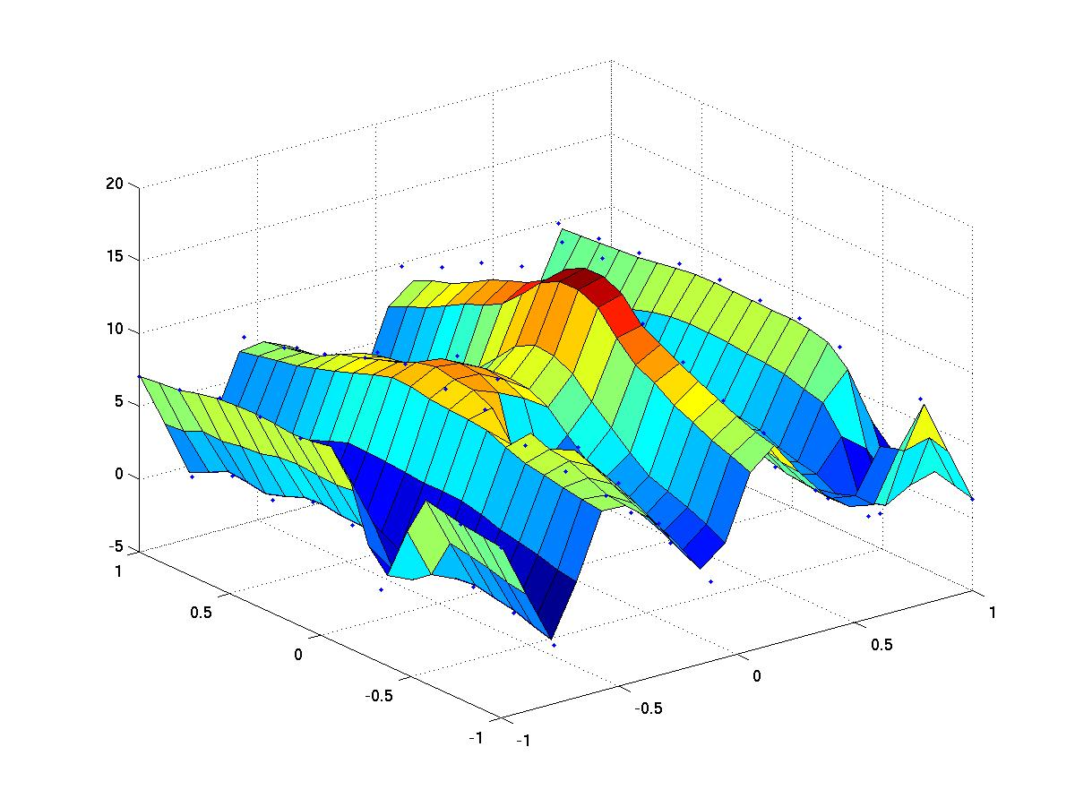

Dealing with Non Uninform Memory Access
Claude TADONKI
MINES ParisTech – PSL Research University
Paris - France
Universidade Federal Fluminense (Niteroi - Brasil) – May 15, 2019

Slide 2



Major Concerns with Manycores
Concurrent accesses to main memory
More complicated cache hierarchy & coherence
Threads scheduling (static and dynamic)
Energy & cooling
Fault tolerance
Manycores can be used as
servers or as parallel computing machines
Non Uniform Memory Access (NUMA)
Claude TADONKI – UFF – Niteroi (Brazil) – May 15, 2019

Slide 3
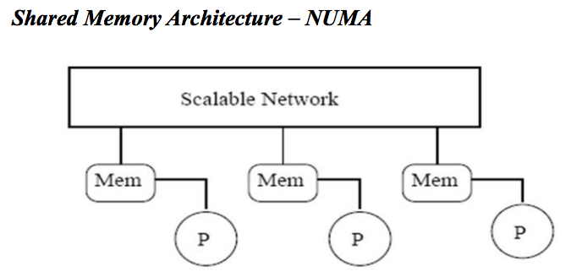
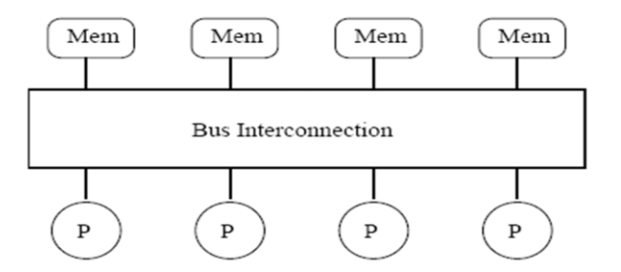
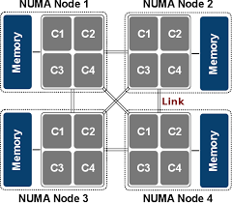
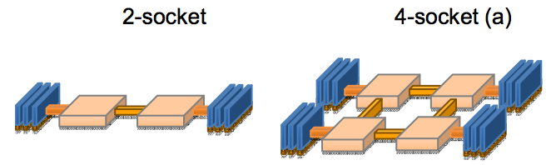
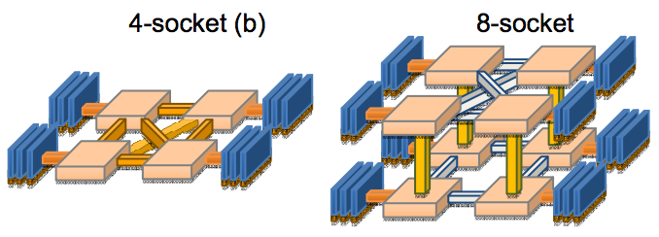
NUMA: Concept & Packaging
UMA
Yinan Li et al.
Non Uniform Memory Access (NUMA)
Claude TADONKI – UFF – Niteroi (Brazil) – May 15, 2019

Slide 4
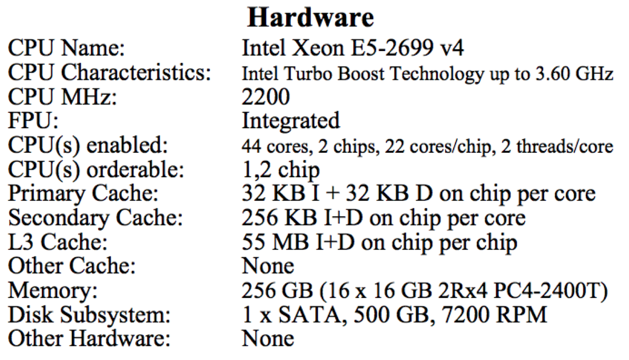

INTEL BROADWELL
Intel® Xeon® Processor E5-2699 v4
Released in April 2016
Each chip has 22 cores organized a 2 NUMA nodes
Each NUMA node has 11 cores
The processor has 2 chips, thus 2 x 2 = 4 NUMA nodes
The total number of cores is 11 x 4 = 44
Non Uniform Memory Access (NUMA)
Claude TADONKI – UFF – Niteroi (Brazil) – May 15, 2019

Slide 5
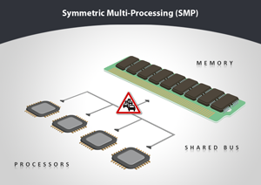
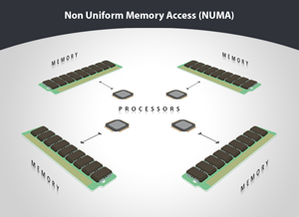
Why NUMA
SMP has a certain level of serialization of concomitant memory accesses
This serialization increases with the number of cores
CPU operates considerably faster than memory accesses: memory wall !!!
Applications with an intensive memory access will show very poor speedups.
NUMA configurations are designed to alleviate the main memory contention
Non Uniform Memory Access (NUMA)
Claude TADONKI – UFF – Niteroi (Brazil) – May 15, 2019

Slide 6

Analogy with a Supermarket
We fill our shopping basket if parallel (clients are completely independent)
But we experience an unpleasant serialization at the checkout
Non Uniform Memory Access (NUMA)
Claude TADONKI – UFF – Niteroi (Brazil) – May 15, 2019

Slide 7
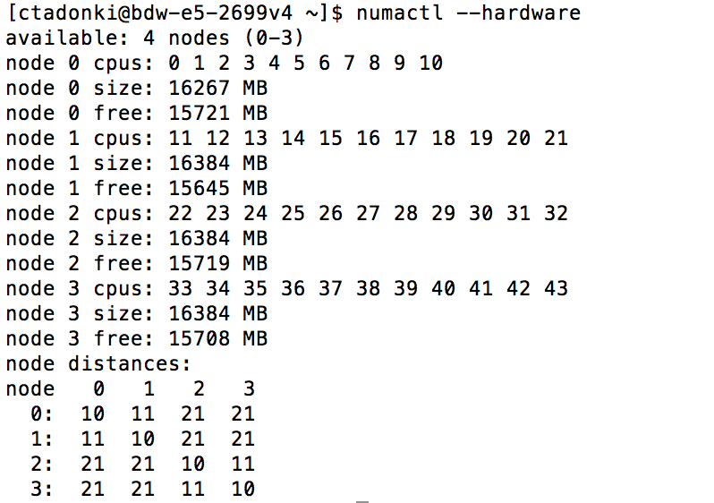
Getting the NUMA configuration
numactl is a utility which can be used to handle NUMA considerations
We can see that we have 4 NUMA nodes (0-3), each with 11 cores
The node distances matrix helps to identify the NUMA topology
Non Uniform Memory Access (NUMA)
Claude TADONKI – UFF – Niteroi (Brazil) – May 15, 2019

Slide 8
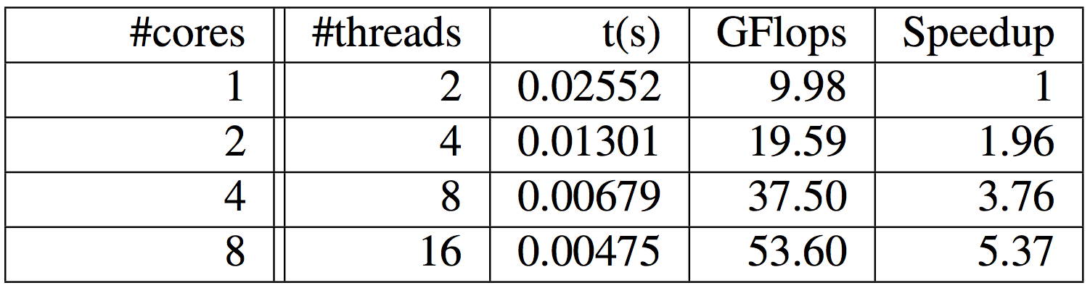

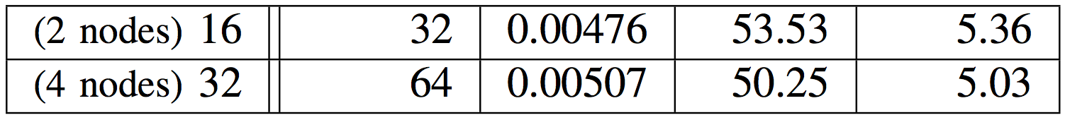

NUMA Unaware Case
Parallelization of Wilson-Dirac operator on a Broadwell-EP
Good scalability within one NUMA node !!!
Non Uniform Memory Access (NUMA)
Claude TADONKI – UFF – Niteroi (Brazil) – May 15, 2019

Slide 9
Summary of NUMA considerations
NUMA Nodes are connected with QPI links
“Local accesses” are of course faster that “remote accesses”
Links between NUMA nodes are potentially subject to heavy contention
It is important to know the topology of the processor (memory and CPU cores)
NUMA-unaware programs are likely to yield a noticeably poor scalability
Memory allocations and thread binding to specific nodes can be controlled by the programmer
Non Uniform Memory Access (NUMA)
Claude TADONKI – UFF – Niteroi (Brazil) – May 15, 2019

Slide 10
Programming & Managing NUMA
NUMA considerations can be handled within programs through libraries like libnuma
#include <numa.h> All command start with the prefix numa_
The library allow to
allocate memory on a specific node
ask to interleave an array on all NUMA nodes
check on which node a given memory space is allocated
identified on which NUMA node a given core (logical id) belongs to
Such libraries should be used with flexibility in order to avoid portability issues
An efficient explicit management of NUMA considerations can improve scalability
Non Uniform Memory Access (NUMA)
Claude TADONKI – UFF – Niteroi (Brazil) – May 15, 2019

Slide 11
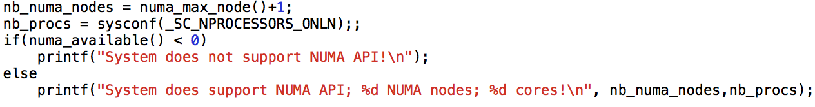

Programming & Managing NUMA
We can get the total number of NUMA nodes with numa_max_node() + 1
We can get the total number of cores with sysconf(_SC_NPROCESSORS_ONLN)
We can check if the system supports NUMA API with numa_available()
Non Uniform Memory Access (NUMA)
Claude TADONKI – UFF – Niteroi (Brazil) – May 15, 2019

Slide 12
Programming & Managing NUMA
We can get the total number of NUMA nodes with numa_max_node() + 1
We can get the total number of cores with sysconf(_SC_NPROCESSORS_ONLN)
We can check if the system supports NUMA API with numa_available()
Non Uniform Memory Access (NUMA)
Claude TADONKI – UFF – Niteroi (Brazil) – May 15, 2019

Slide 13
Programming & Managing NUMA
We can get the total number of NUMA nodes with numa_max_node() + 1
We can get the total number of cores with sysconf(_SC_NPROCESSORS_ONLN)
We can check if the system supports NUMA API with numa_available()
We allocate the memory on a specific node (node_id) using numa_malloc_onnode()
The memory allocated using numa_malloc_onnode() is released using numa_free()
Non Uniform Memory Access (NUMA)
Claude TADONKI – UFF – Niteroi (Brazil) – May 15, 2019

Slide 14
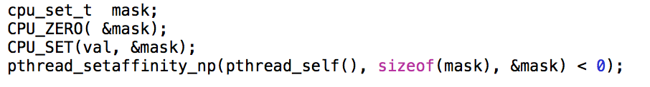
Programming & Managing NUMA
We can bind a thread to a specific core (using its id)
We should consider the global NUMA packaging when allocating a thread to a core
Non Uniform Memory Access (NUMA)
Claude TADONKI – UFF – Niteroi (Brazil) – May 15, 2019

Slide 15
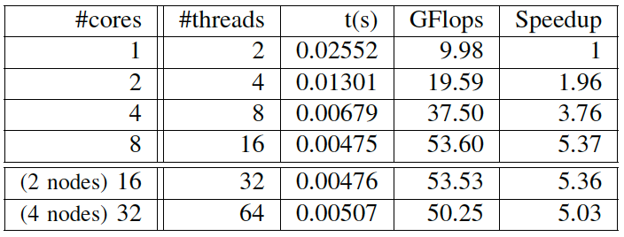
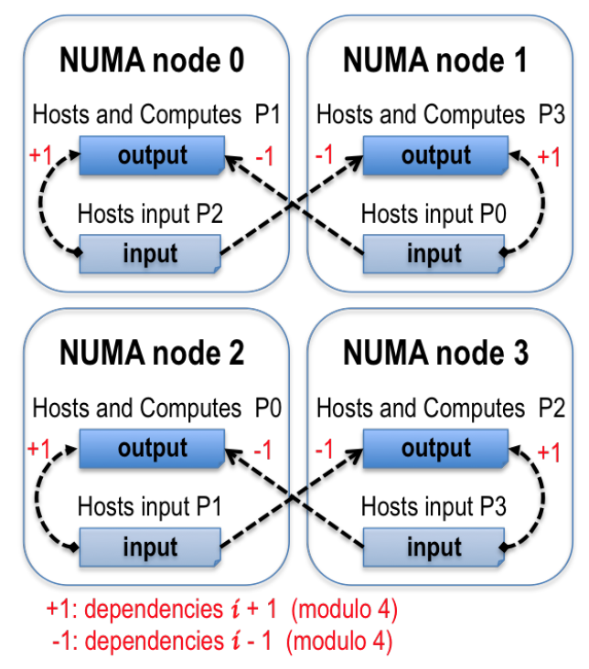
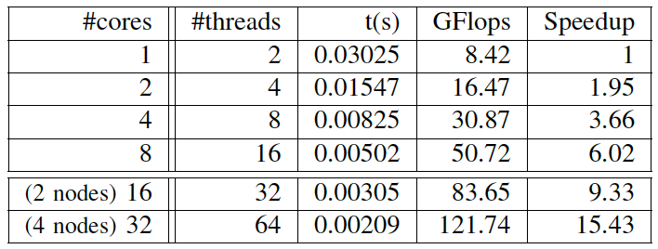
NUMA-aware Wilson-Dirac
High Performance Computing and Simulation (HPCS) 2017 – Genoa (Italy)
Non Uniform Memory Access (NUMA)
Claude TADONKI – UFF – Niteroi (Brazil) – May 15, 2019

Slide 16

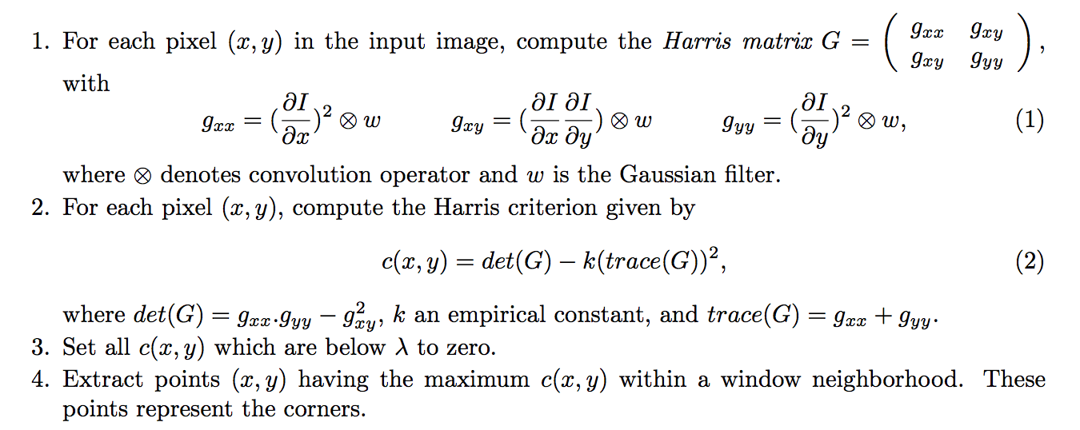
Harris Corner Detection
Non Uniform Memory Access (NUMA)
Claude TADONKI – UFF – Niteroi (Brazil) – May 15, 2019

Slide 17
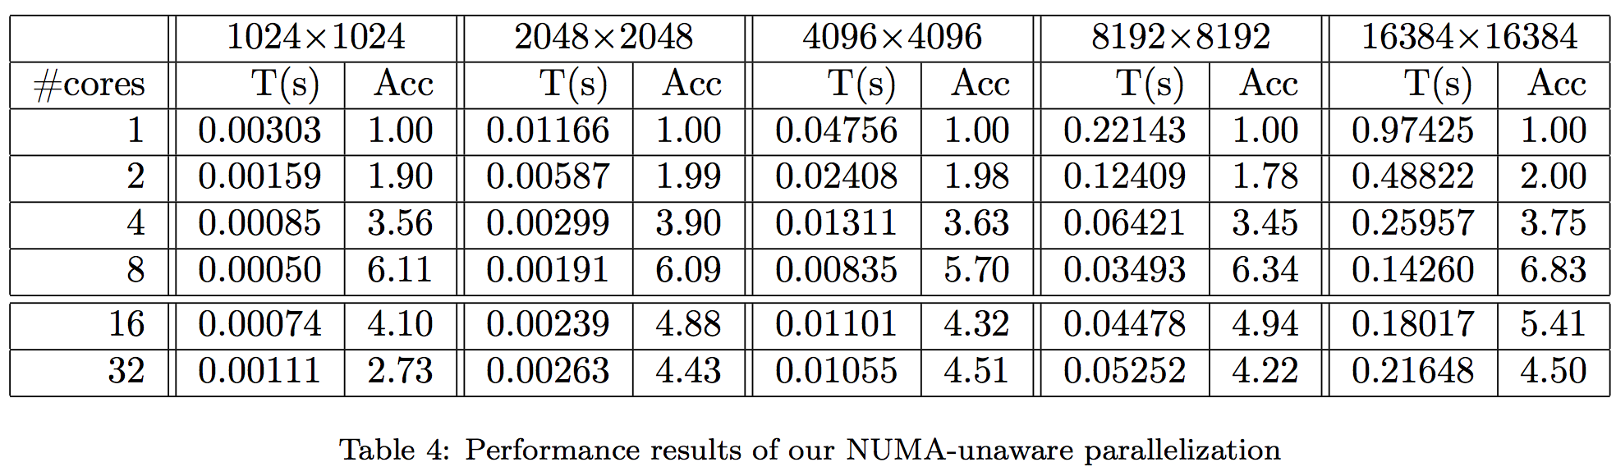
NUMA-aware Corner Detection
Non Uniform Memory Access (NUMA)
Claude TADONKI – UFF – Niteroi (Brazil) – May 15, 2019

Slide 18
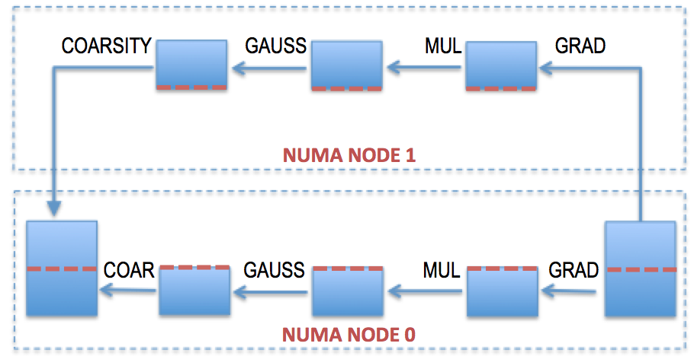
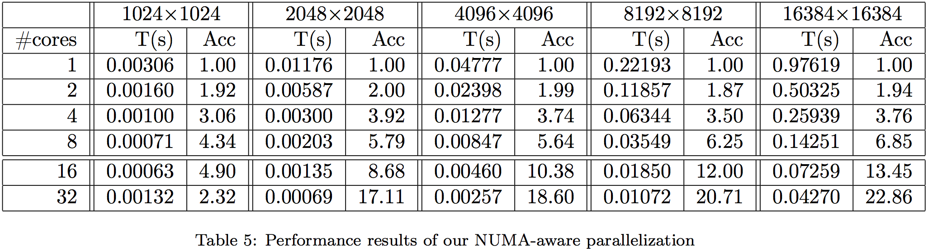
NUMA-aware Corner Detection
Future Generation Computing Systems (FGCS) 2018
Non Uniform Memory Access (NUMA)
Claude TADONKI – UFF – Niteroi (Brazil) – May 15, 2019

Slide 19

End
Thanks for your attention
High Performance Computing
Claude TADONKI – UFRJ – Rio de Janeiro (Brazil) – May 13, 2019

