Slide 1
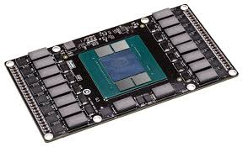
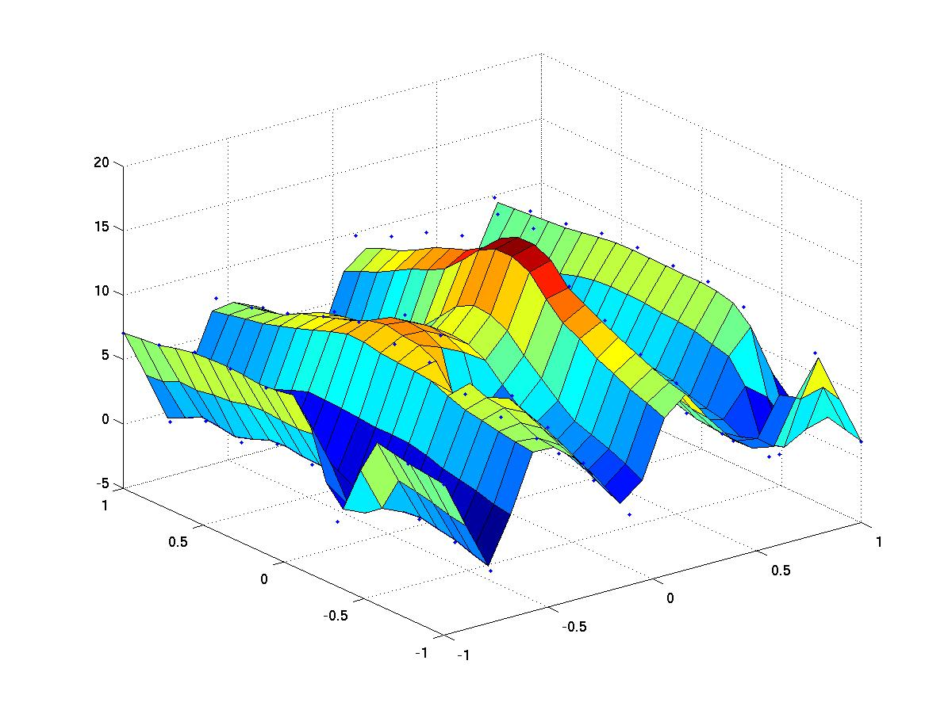


High Performance Computing
Synopsis of Technical and Programming Concepts
Claude TADONKI
MINES ParisTech – PSL Research University
Paris - France
INSISCOS 2016
Universidad Tecnológica Equinoccial (UTE) – Quito (Ecuador) – November 25, 2016

Slide 2

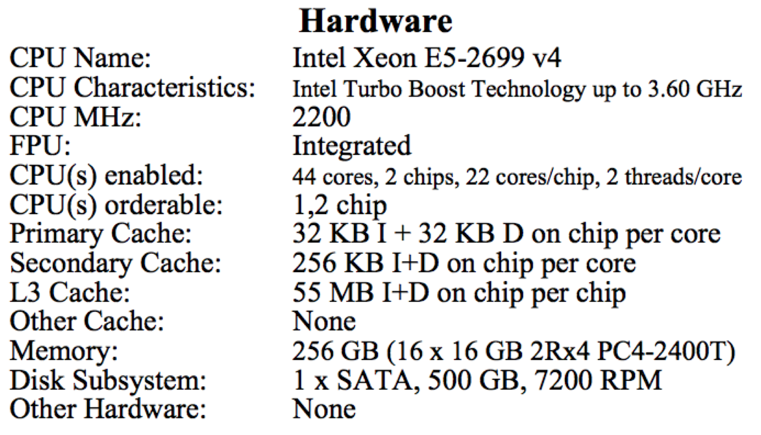

INTEL BROADWELL
Intel® Xeon® Processor E5-2699 v4
Released in April 2016
22x2 = 44 cores
2.2 Ghz/core
3.6 GHz Boost
Hyperthreading
256-bit vectors
256 Gb RAM
76.8 Gb/s
500 Gb disk
1.54 Tflops SP
0.78 Tflops DP
Tflops is 1000 000 000 000 (1 billion) floating point operations per seconds
High Performance Computing
Claude TADONKI – INSISCOS 2016 – UTE Quito (Ecuador) – November 25, 2016

Slide 3
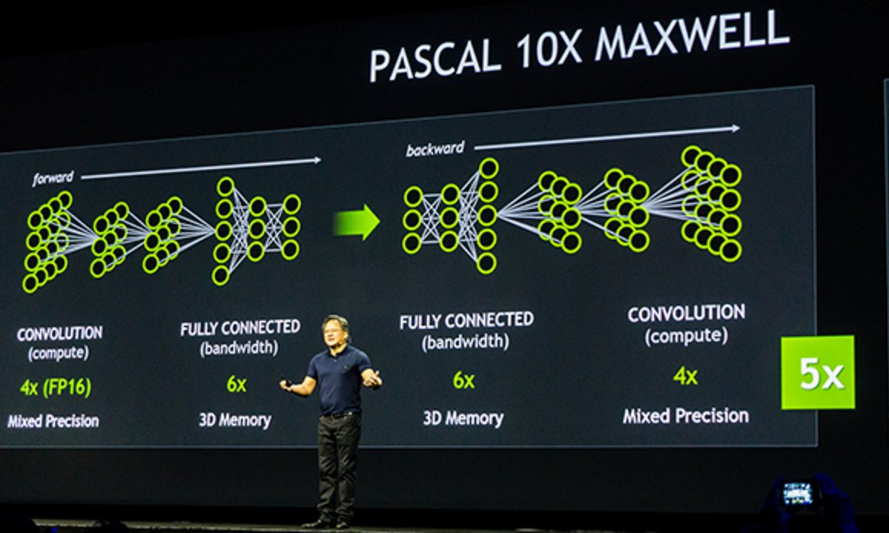
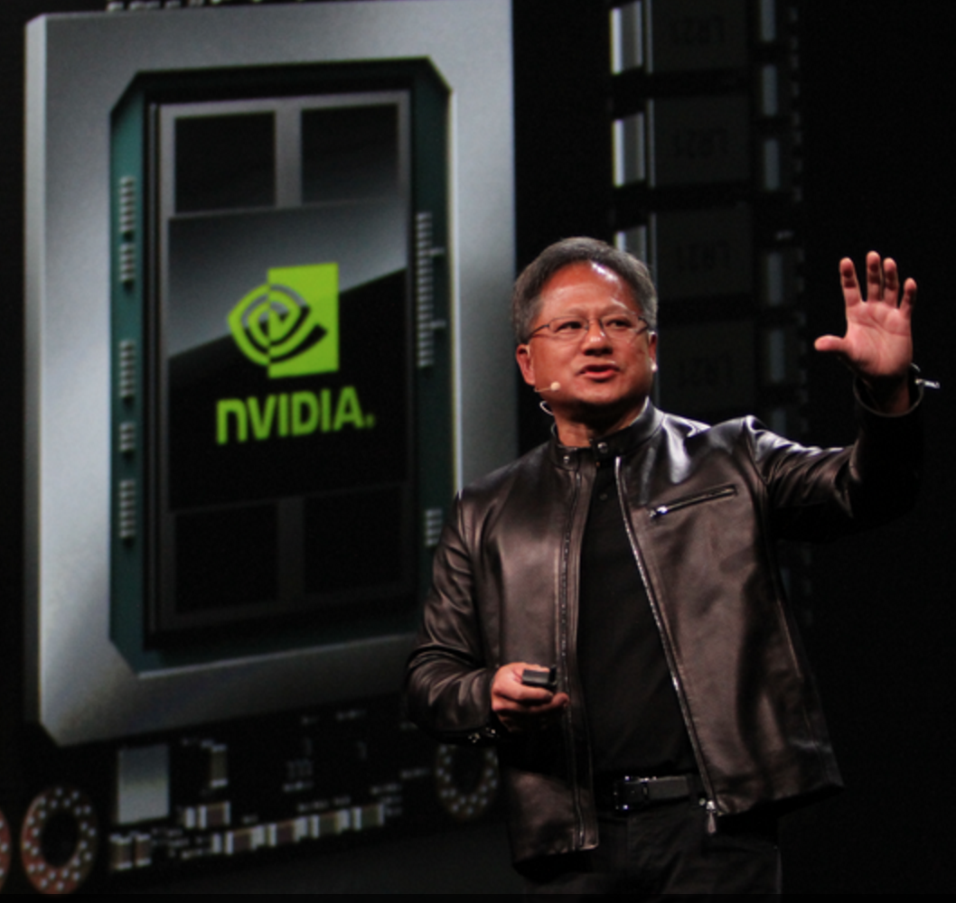
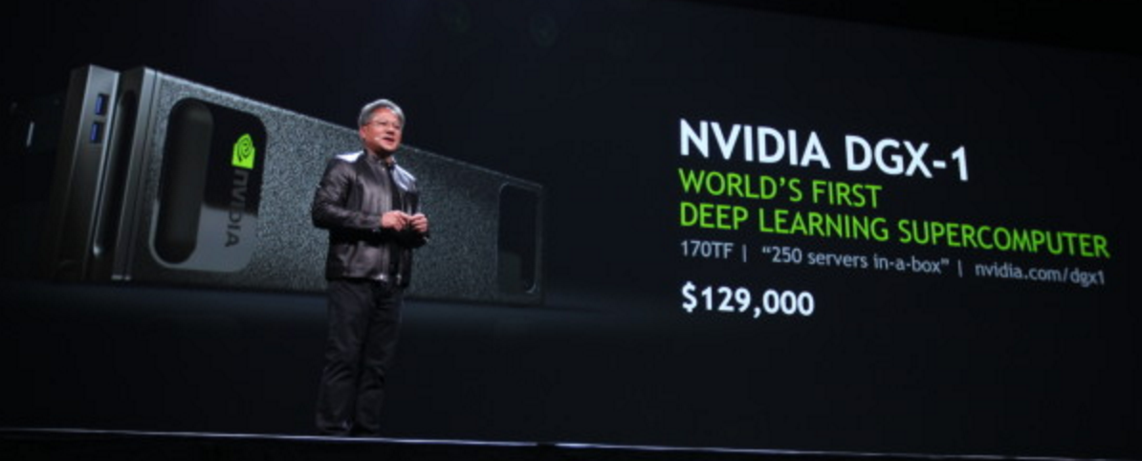
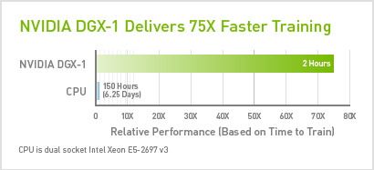
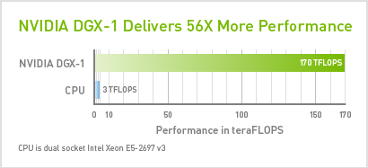
NVIDIA DGX-1
$129,000 US
Released in April 2016
NVDIA supercomputing solution
8 Tesla P100 GPUs (Pascal GPU based)
Dual Intel Xheon processors (host)
170 Tflops FP16 peak perf
7 Tb of SSD Storage
Aggregate bandwidth 768 Gb/s
Perf throughput 250 x86 servers
Pascal GPU: 3584 CUDA Cores; 1480 MHz; 16 GB RAM at 720 Gb/s 5thGen
We should understand that GPU is specialized for specific tasks where it is likely to show up noticeable performances
High Performance Computing
Claude TADONKI – INSISCOS 2016 – UTE Quito (Ecuador) – November 25, 2016

Slide 4
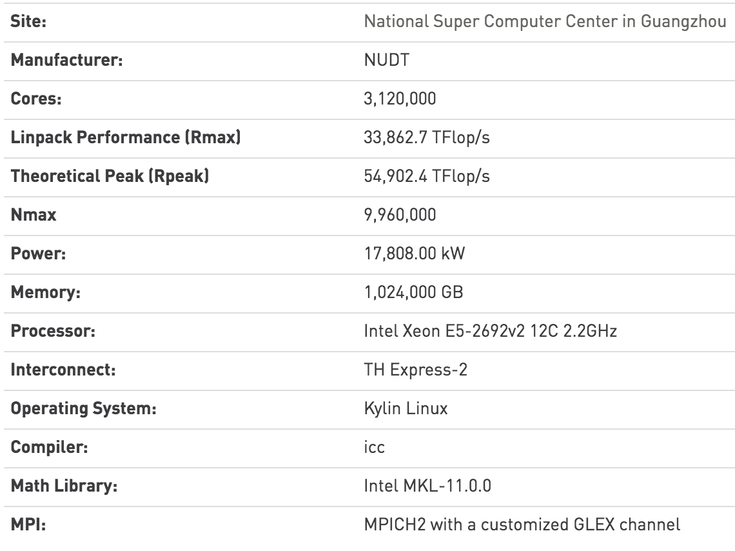

N°1 SUPERCOMPUTER
Top500 - Nov 2015
TIANHE-2 (MILKYWAY-2)
In China
Intel Xheon E5
260, 000 nodes
3 million cores
54 PFlops peak
33 PFlops (61%)
High Performance Computing
Claude TADONKI – INSISCOS 2016 – UTE Quito (Ecuador) – November 25, 2016

Slide 5
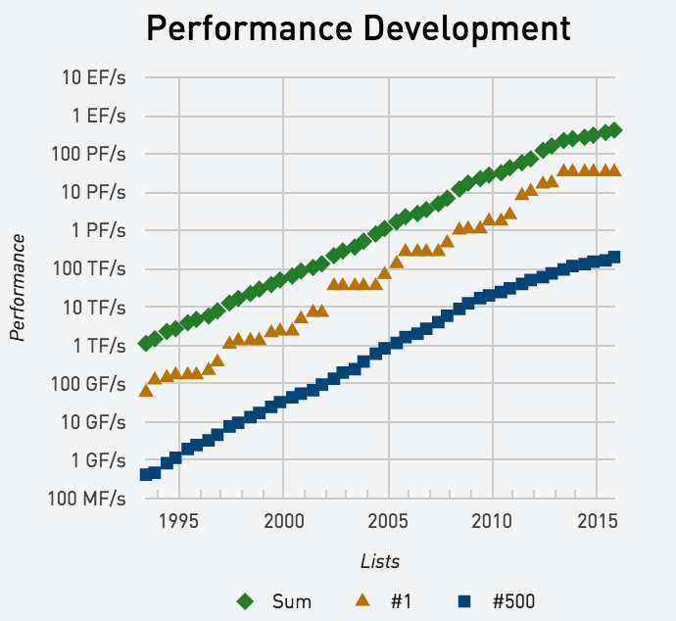
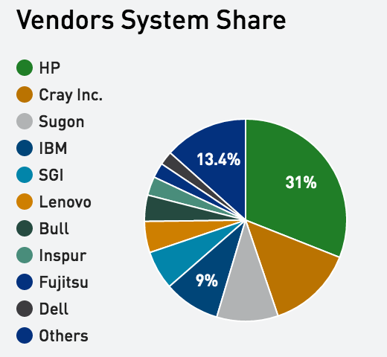
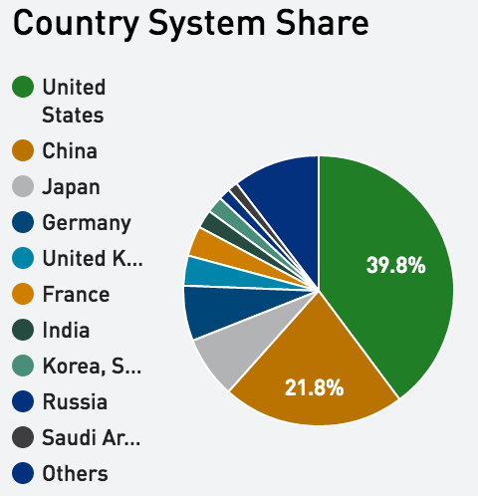
Performances Evolution
Ss
We are moving toward ExaFlops (E = Exa = 10¹⁸)
High Performance Computing
Claude TADONKI – INSISCOS 2016 – UTE Quito (Ecuador) – November 25, 2016

Slide 6
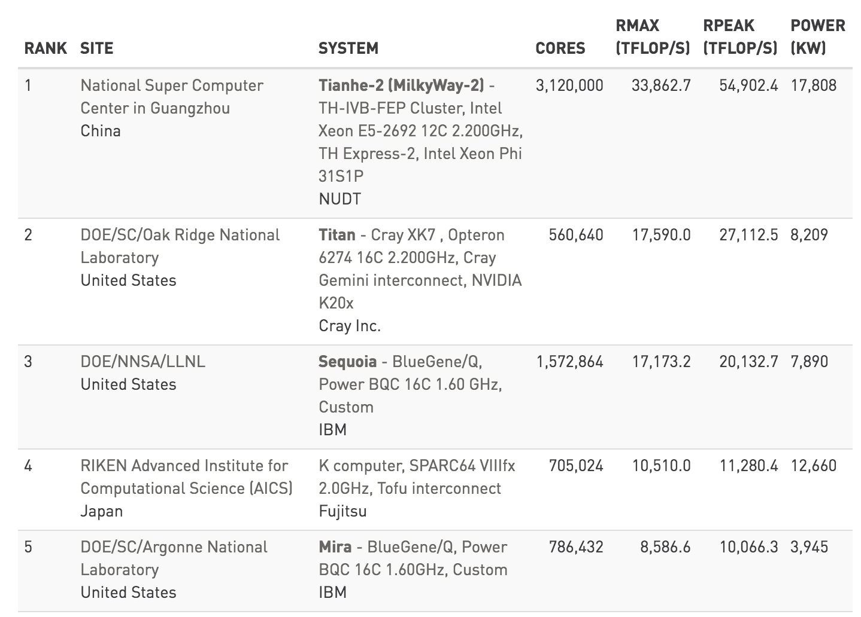
TOP500
Top 5 sites - Top500 - Nov 2015
High Performance Computing
Claude TADONKI – INSISCOS 2016 – UTE Quito (Ecuador) – November 25, 2016

Slide 7

Peak Performance Evaluation
Getting Tianhe-2 RPEAK:
CPU-core frequency: 2.2 Ghz = 2.2 GFlops
Considering the vector capability (256-bit wide - 4 DP): 4 x 2.2 = 8.8 GFlops
Given the CPU can do ADD and MUL in one cycle (FMA): 2 x 8.8 = 17.6 GFlops
Finally the total number of cpu-cores: 3,120,000 x 17.6 Ghz = 54.912 PFlops
Clearly, we should exploit all levels of parallelism, if we need to harvest an acceptable fraction of the peak performance.
High Performance Computing
Claude TADONKI – INSISCOS 2016 – UTE Quito (Ecuador) – November 25, 2016

Slide 8
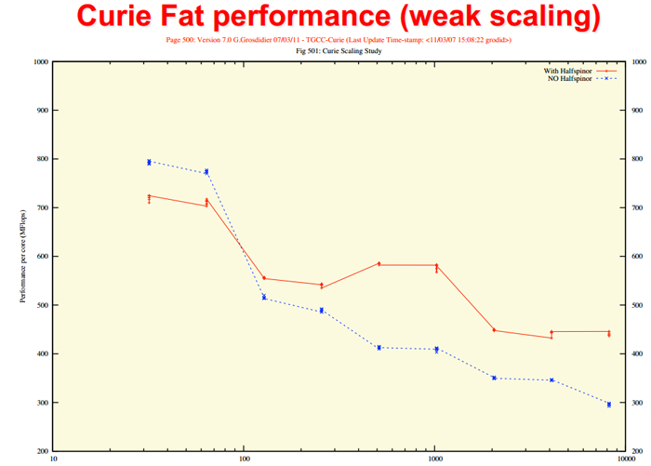

Peak vs Sustained
Not counted in peak performance:
Memory accesses
Interprocessor communications
We got here a sustained
performance per core of
500 Mflops over 9 GFlops
G.Grosdidier, « Scaling stories », PetaQCD Final Review Meeting, Orsay, Sept. 27th – 28th 2012
500 Mflops/core
High Performance Computing
Claude TADONKI – INSISCOS 2016 – UTE Quito (Ecuador) – November 25, 2016

Slide 9
How to Program a Supercomputer
[1]
Message passing between nodes (MPI, …)
Shared memory between cores (Pthreads, OpenMP, …)
Vector computing inside a core (SSE, AVX, …)
[2]
[3]
[2]
Main (shared) Memory
core
core
core
scalar & vector
units
scalar & vector
units
scalar & vector
units
[3]
[1]
[1]
[2]
[2]
Main (shared) Memory
Main (shared) Memory
[1]
core
core
core
core
core
core
scalar & vector
units
scalar & vector
units
scalar & vector
units
scalar & vector
units
scalar & vector
units
scalar & vector
units
[3]
[3]
High Performance Computing
Claude TADONKI – INSISCOS 2016 – UTE Quito (Ecuador) – November 25, 2016

Slide 10
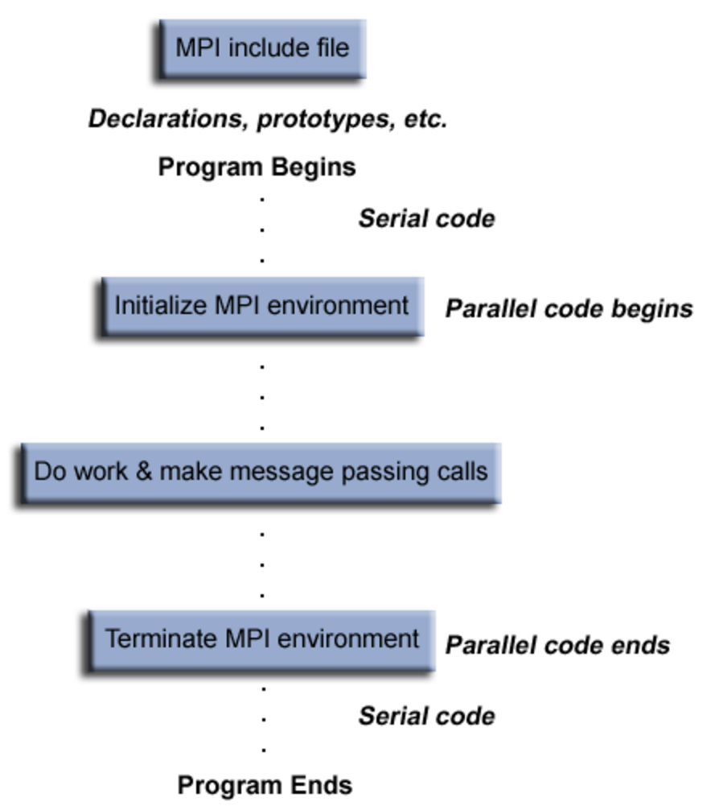
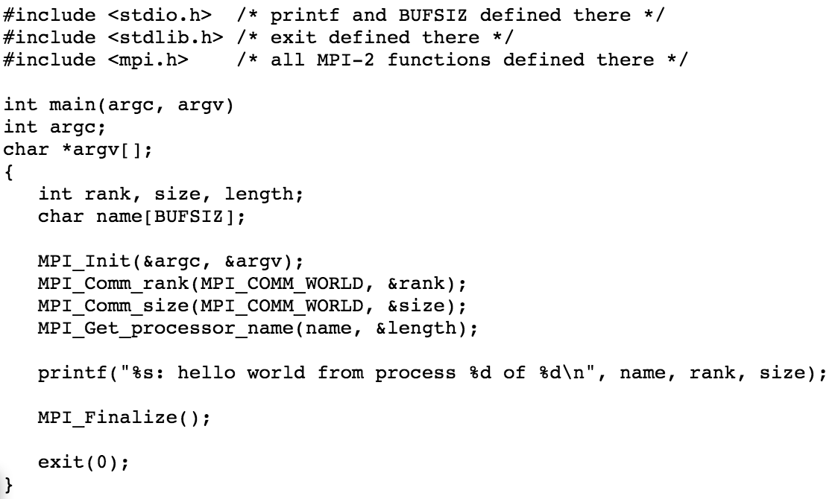
Message Passing Programming
This is the typical way to execute across several independent compute nodes
The whole program is decomposed at runtime into several processes
Processes exchange data among themselves using message passing routines
The standard programming model is SPMD (Single Program Multiple Data)
High Performance Computing
Claude TADONKI – INSISCOS 2016 – UTE Quito (Ecuador) – November 25, 2016

Slide 11
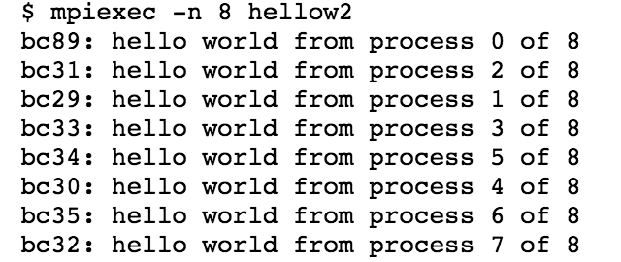
Message Passing Programming
MPI code is compiled with mpicc -o myprogram myprogram.c
Our MPI program is launched with the command mpirun myprogram –np 8
The value passed through “-np” is the number of processes
The number of processes can be higher or lower than the number of processors.
The scalability of your MPI code will mainly depends on data exchanges overhead
Every MPI command starts with the prefix “MPI_”
There several implementations and versions of MPI, but portability is preserved
High Performance Computing
Claude TADONKI – INSISCOS 2016 – UTE Quito (Ecuador) – November 25, 2016

Slide 12
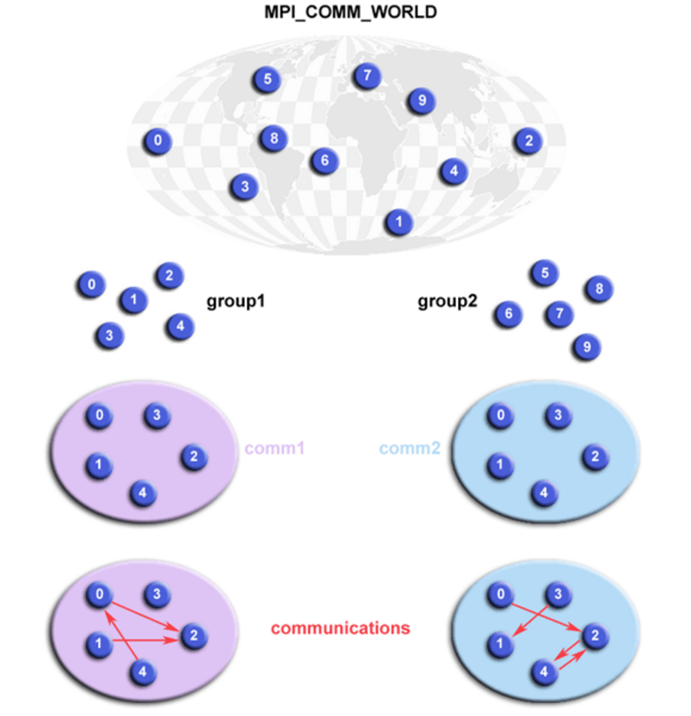
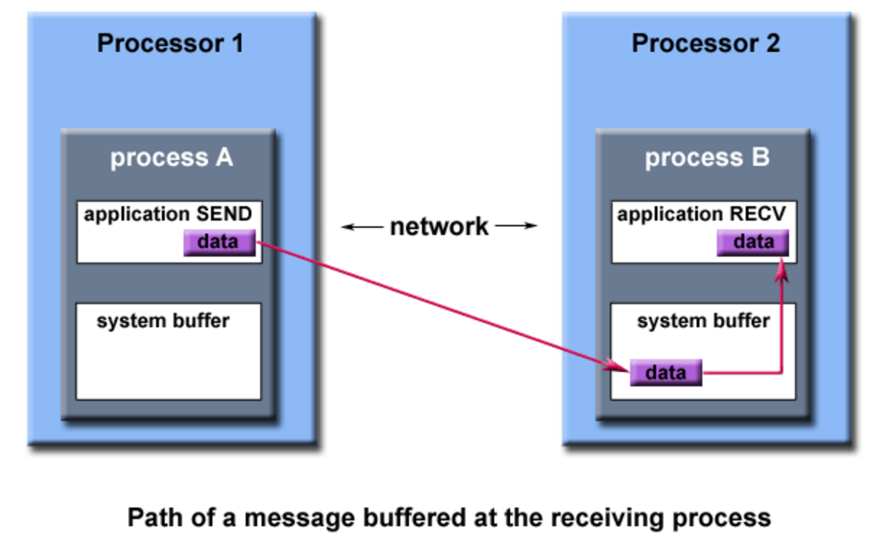
Message Passing Programming
MPI commands can be roughly grouped into three categories
  Environment Management Routines
  Communication Routines (point-to-point – collective - synchronization)
  Group Communicator Management Routines
From here you just need to delve into MPI documentation for details & specific needs
The global performance of your program will depend on both the parallel algorithm behind and the quality of the corresponding parallel program 2 skills involved!!!
High Performance Computing
Claude TADONKI – INSISCOS 2016 – UTE Quito (Ecuador) – November 25, 2016

Slide 13
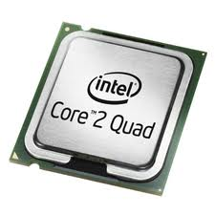
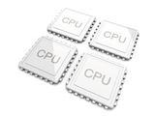
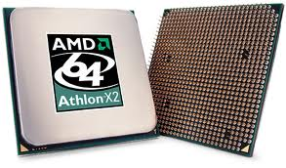



Multithreaded Programming
Although we can still use the message passing approach for multicore machines,
it is important to know that there is a specific paradigm for this context.
High Performance Computing
Claude TADONKI – INSISCOS 2016 – UTE Quito (Ecuador) – November 25, 2016

Slide 14
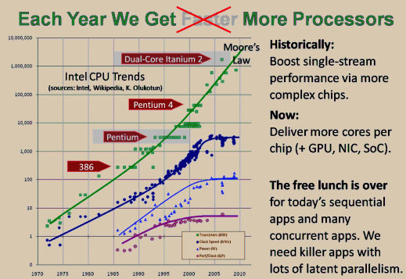
Multithreaded Programming
HISTORICAL CONTEXT AND TREND
We observe a stagnation of the processor frequency (tends to decreases)
We need to keep following the trend of Moore’s Law (transistors count)
In order to scale up with processor speed, we need more cores per chip
The number of cores per chip is increasing, but with complex memory system
High Performance Computing
Claude TADONKI – INSISCOS 2016 – UTE Quito (Ecuador) – November 25, 2016

Slide 15
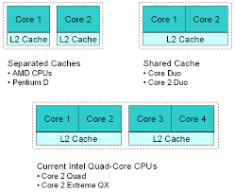
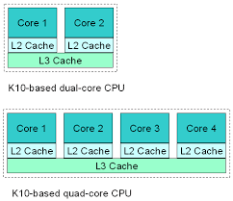
Multithreaded Programming
PACKAGING & HIERARCHICAL MEMORY
The cores always share the main memory and there are different cache levels
Cache memories are distributed among the cores depending on the packaging
A given core might be able to get data from non-local unshared caches
Cache coherency is guarantee by the hardware and associated protocols
High Performance Computing
Claude TADONKI – INSISCOS 2016 – UTE Quito (Ecuador) – November 25, 2016

Slide 16
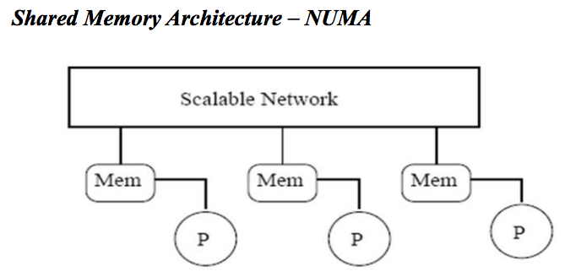
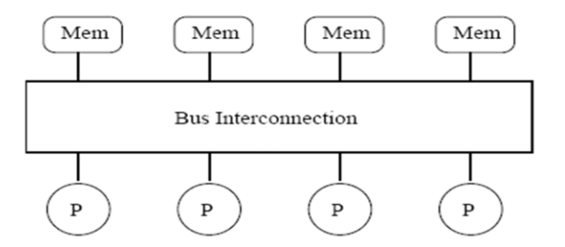
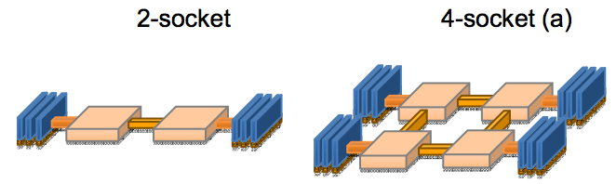
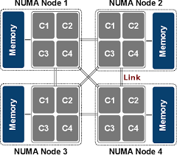
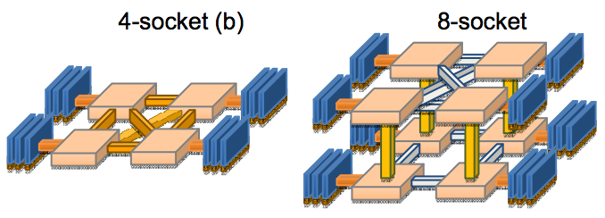
Multithreaded Programming
PACKAGING AND NUMA CONSIDERATION
UMA
Yinan Li et al.
Serious source of scalability issues
High Performance Computing
Claude TADONKI – INSISCOS 2016 – UTE Quito (Ecuador) – November 25, 2016

Slide 17

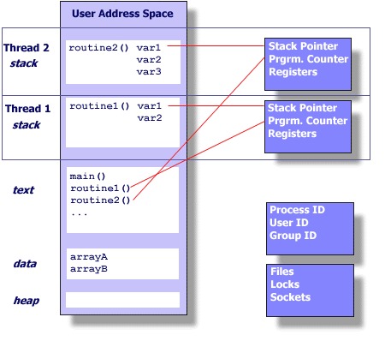
Multithreaded Programming
THREAD
In a program, an independent section or a routine can be executed as a thread.
A multi-threaded program is a program
that contains several concurrent threads.
A thread can be seen as a lightweight process (memory is shared among threads).
A thread is a child of a (OS) process. Thus it uses the main resources of the process (shared between all running threads),
while keeping its own
  Stack pointer
  Registers
  Scheduling properties (policy ,priority)
  Set of pending and blocked signals
  Thread specific data.
High Performance Computing
Claude TADONKI – INSISCOS 2016 – UTE Quito (Ecuador) – November 25, 2016

Slide 18

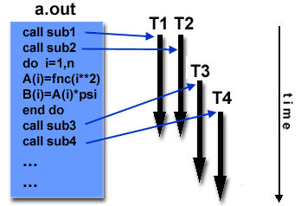
Multithreaded Programming
A threaded program is built from a classical program by embedding the execution of some of its subroutines within the framework of associated threads.
Typical scenario to design a threaded program implies
calls to a specialized library (thread implementation)
programming directives for threads creation
appropriate compiler directives
There are several (incompatible) implementations of threads depending on
the target architecture (vendors) or the operating system.
This impacts on programs portability.
Two standard implementations of threads are: POSIX Threads and OpenMP.
High Performance Computing
Claude TADONKI – INSISCOS 2016 – UTE Quito (Ecuador) – November 25, 2016

Slide 19
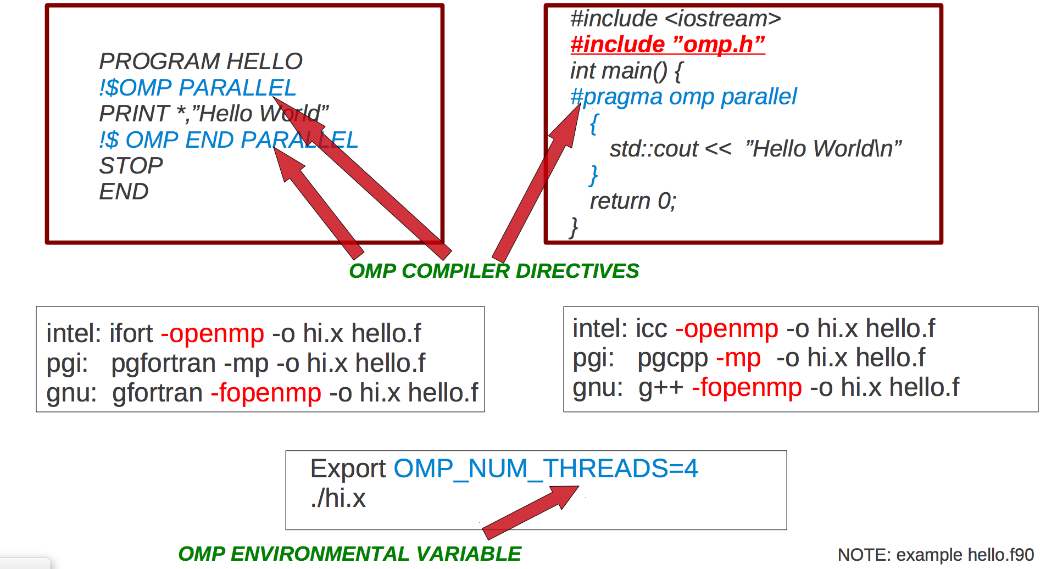
Multithreaded Programming
OpenMP
Directives oriented compiler for multithreaded programming
High Performance Computing
Claude TADONKI – INSISCOS 2016 – UTE Quito (Ecuador) – November 25, 2016

Slide 20
Multithreaded Programming
Pthread
Pthread library contains hundred of routines that can be grouped into 4 categories:
Thread management: Routines to create, terminate, and manage the threads.
Mutexes: Routines for synchronization (through a “mutex” ≈ mutual exclusion ).
Condition variables: Routines for communications between threads that share a mutex.
Synchronization: Routines for the management of read/write locks and barriers.
All identifiers of the Pthreads routines and data types are prefixed with « pthread_ »
Example: pthread_create, thread_join, pthread_t, …
For portability, the pthread.h header file should be included in each source file
The generic compile command is
« cc –lpthread » or « cc –pthread »,
cc = compiler
High Performance Computing
Claude TADONKI – INSISCOS 2016 – UTE Quito (Ecuador) – November 25, 2016

Slide 21

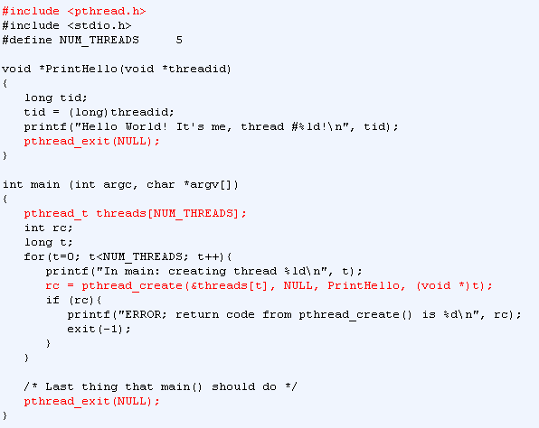
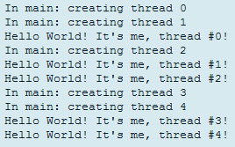
Multithreaded Programming
High Performance Computing
Claude TADONKI – INSISCOS 2016 – UTE Quito (Ecuador) – November 25, 2016

Slide 22
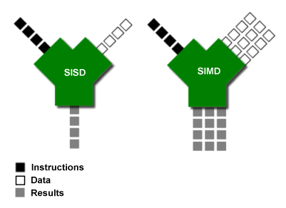
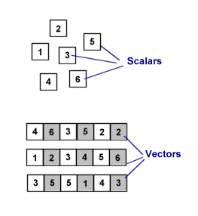
Vector Programming
A SIMD machine simultaneously operates on tuples of atomic data (one instruction).
SIMD is opposed to SCALAR (the traditional mechanism).
SIMD is about exploiting parallelism in the data stream (DLP) , while superscalar SISD is
about exploiting parallelism in the instruction stream (ILP).
SIMD is usually referred as VECTOR COMPUTING, since its basic unit is the vector.
Vectors are represented in what is called packed data format stored into vector registers.
On a given machine, the length/number of the vector registers are fixed
SIMD can be implemented on using specific extensions MMX, SSE, AVX, …
High Performance Computing
Claude TADONKI – INSISCOS 2016 – UTE Quito (Ecuador) – November 25, 2016

Slide 23
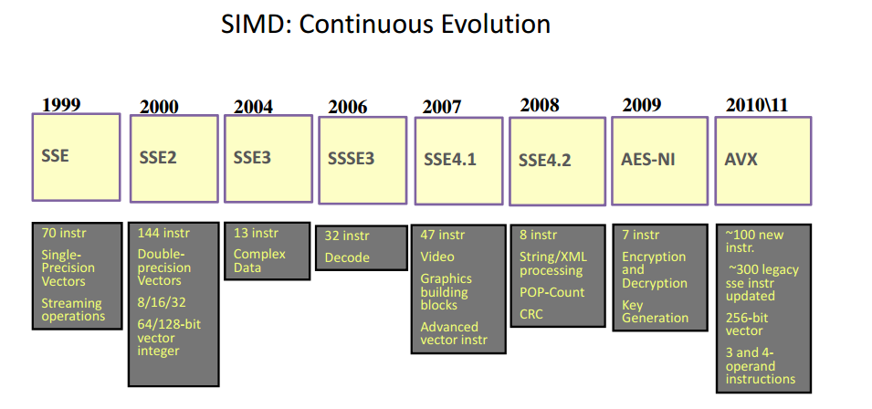
Vector Programming
SIMD Implementation
Then AVX2, MIC, …
Vector instructions can be used from their native form or through intrinsics
High Performance Computing
Claude TADONKI – INSISCOS 2016 – UTE Quito (Ecuador) – November 25, 2016

Slide 24
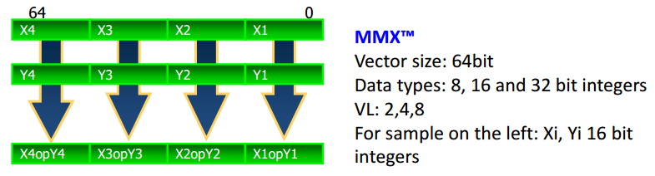
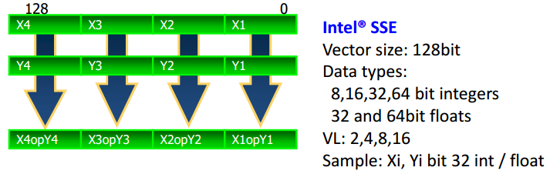
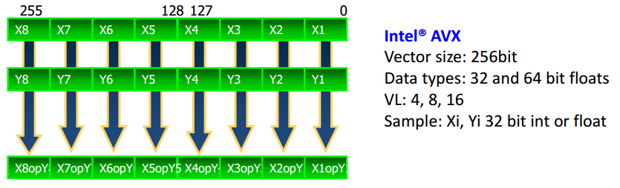
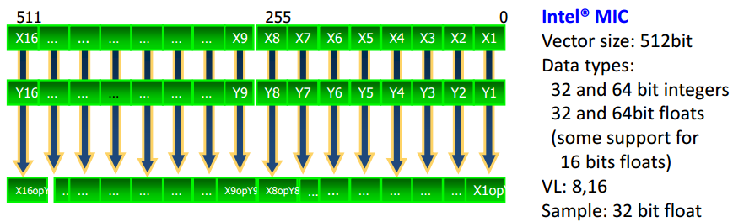
Vector Programming
MMX = MultiMedia eXtension
SSE = Streaming SIMD Extension
AVX = Advanced Vector Extensions
MIC = Many Integrated Core
High Performance Computing
Claude TADONKI – INSISCOS 2016 – UTE Quito (Ecuador) – November 25, 2016

Slide 25
Vector Programming
SSE = Streaming SIMD Extensions
SEE programming can be done either through (inline) assembly or
from a high-level language (C and C++) using intrinsics.
The {x,e,p}mmintrin.h header file contains the declarations for the SSEx instructions intrinsics.
xmmintrin.h -> SSE
emmintrin.h -> SSE2
pmmintrin.h -> SSE3
SSE instruction sets can be enabled or disabled. If disabled, SSE instructions will not be possible.
It is ecommended to leave this BIOS feature enabled by default.
In any case MMX (MultiMedia eXtensions) will still available.
Compile your SSE code with "gcc -o vector vector.c -msse -msse2 -msse3“
SSE intrinsics use types __m128 (float) , __m128i (int, short, char), and __m128d (double)
Variable of type __m128, __m128i, and __m128d (exclusive use)
maps to the XMM[0-7] registers (128 bits), and automatically aligned on 16-byte boundaries.
Vector registers are xmm0, xmm1, …, xmm7. Initially, they could only be used for single
precision computation. Since SSE2, they can be used for any primitive data type.
High Performance Computing
Claude TADONKI – INSISCOS 2016 – UTE Quito (Ecuador) – November 25, 2016

Slide 26
Vector Programming
SSE (Connecting vectors to scalar data)
Vector variables can be connected to scalar variables (arrays) using one of the following ways
float a[N] __attribute__((aligned(16)));
__m128 *ptr = (__m128*)a;
prt[i] or *(ptr+i) represents the vector
{a[4i], a[4i+1], a[4i+2], a[4i+3]}
float a[N] __attribute__((aligned(16)));
__m128 mm_a;
mm_a = _mm_load_pd(&a[4i]); // here we explicitly load data into the vector
mm_a represents the vector
{a[4i], a[4i+1], a[4i+2], a[4i+3]}
Using the above connections, we can now use SSE instruction to process our data.
This can be done through
(inline) assembly
intrinsics (interface to keep using high-level instructions to perform vector operations)
High Performance Computing
Claude TADONKI – INSISCOS 2016 – UTE Quito (Ecuador) – November 25, 2016

Slide 27

Vector Programming
SSE (illustrations)
void scalar_sqrt(float *a){
int i;
for(i = 0; i < N; i++)
a[i] = sqrt(a[i]);
}
Scalar version
void sse_sqrt(float *a){
// We assume N % 4 == 0.
int nb_iters = N / 4;
__m128 *ptr = (__m128*)a;
int i;
for(i = 0; i < nb_iters; i++, ptr++, a += 4)
_mm_store_ps(a, _mm_sqrt_ps(*ptr));
}
Vector version (SSE)
10 times faster !!!!!!!
High Performance Computing
Claude TADONKI – INSISCOS 2016 – UTE Quito (Ecuador) – November 25, 2016

Slide 28
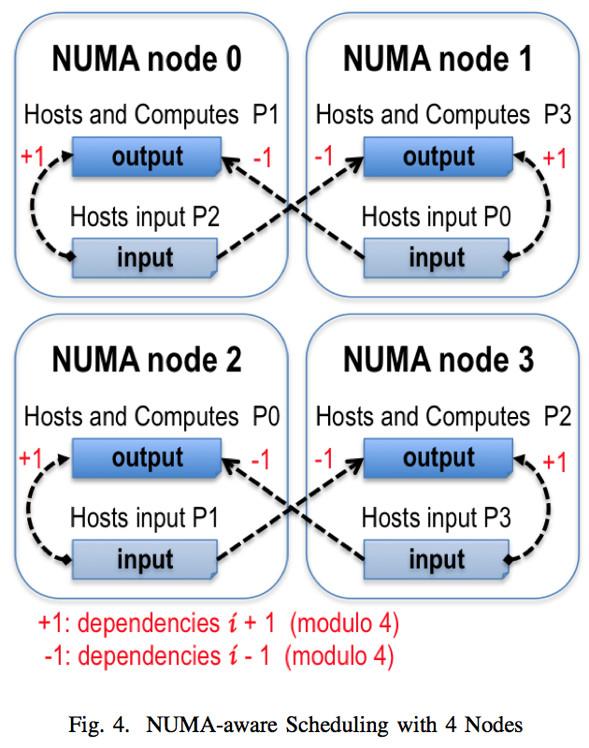
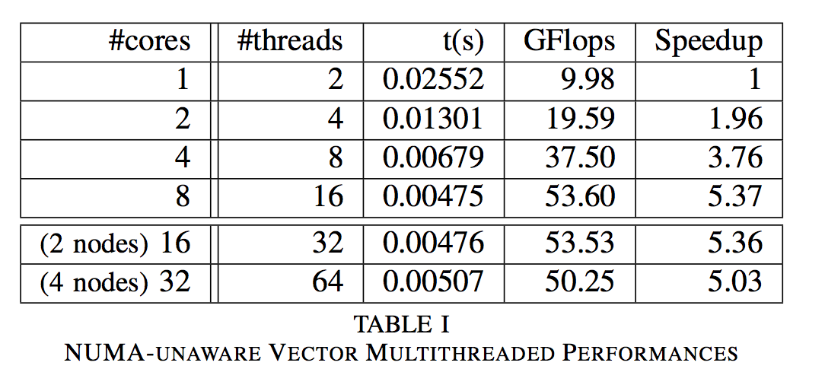

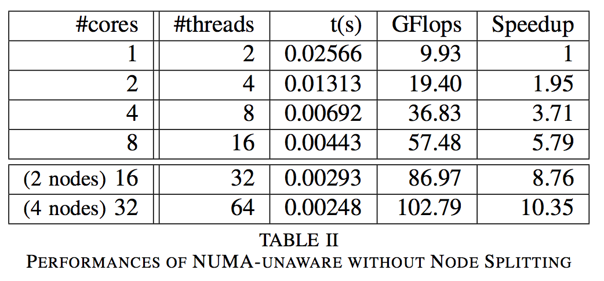
Case Study: LQCD
We need to solve the Wilson-Dirac equation at the fastest !!!!
High Performance Computing
Claude TADONKI – INSISCOS 2016 – UTE Quito (Ecuador) – November 25, 2016

Slide 29


Conclusion
HPC is making noticeable progresses, but we still need to skillfully use
its elements and concepts in order to reach our performance expectations.
There is no free launch
High Performance Computing
Claude TADONKI – INSISCOS 2016 – UTE Quito (Ecuador) – November 25, 2016

Slide 30

End
Thanks for your attention
Por favor, se puede preguntar en espagnol.
High Performance Computing
Claude TADONKI – INSISCOS 2016 – UTE Quito (Ecuador) – November 25, 2016

