Slide 1
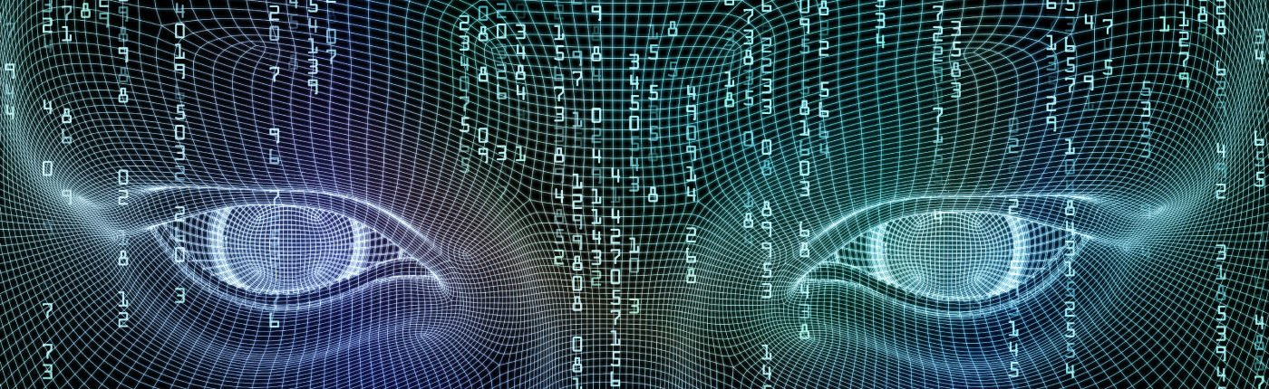

High Performance Artificial Intelligence
Claude TADONKI
MINES Paris - PSL
Seminar at Universidade Federal Fluminense (UFF)
April 19 - 2023

Slide 2




New Era for HPC: Exascale
Exascale 2022
Pr. Jack Dongarra
Worldwide HPC leader
Founder of the Top500 ranking
Turing Award 2021
With Pr. Jack Dongarra at SC22 (Dallas/USA)
High Performance Artificial Intelligence
Seminar at Universidade Federal Fluminense (UFF- Niteroi / Brazil) – April 19, 2023

Slide 3
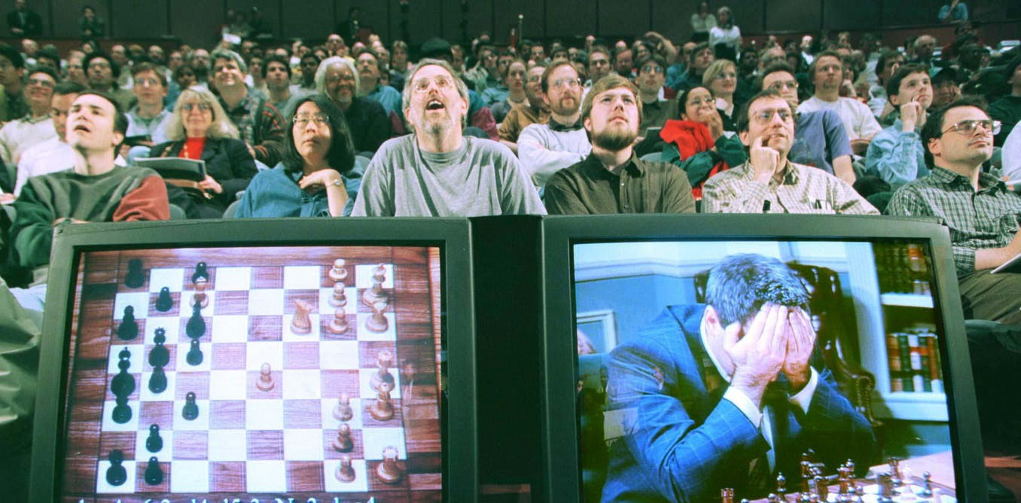
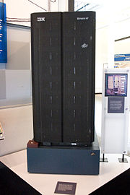
A Historical Case
Deep Blue versus Garry Kasparov (1997)
Deep Blue
Victory of Deep Blue (IBM Supercomputer) over Kasparov (Human)
Deep Blue had a database of the most important chess games of the 20th century
Deep Blue was able to analyze 200 millions of moves per second
Deep Blue was a 11.4 GFlops machine, the current world fastest machine is 1.685 EFlops
X 0.15x10⁹
High Performance Artificial Intelligence
Seminar at Universidade Federal Fluminense (UFF- Niteroi / Brazil) – April 19, 2023

Slide 4
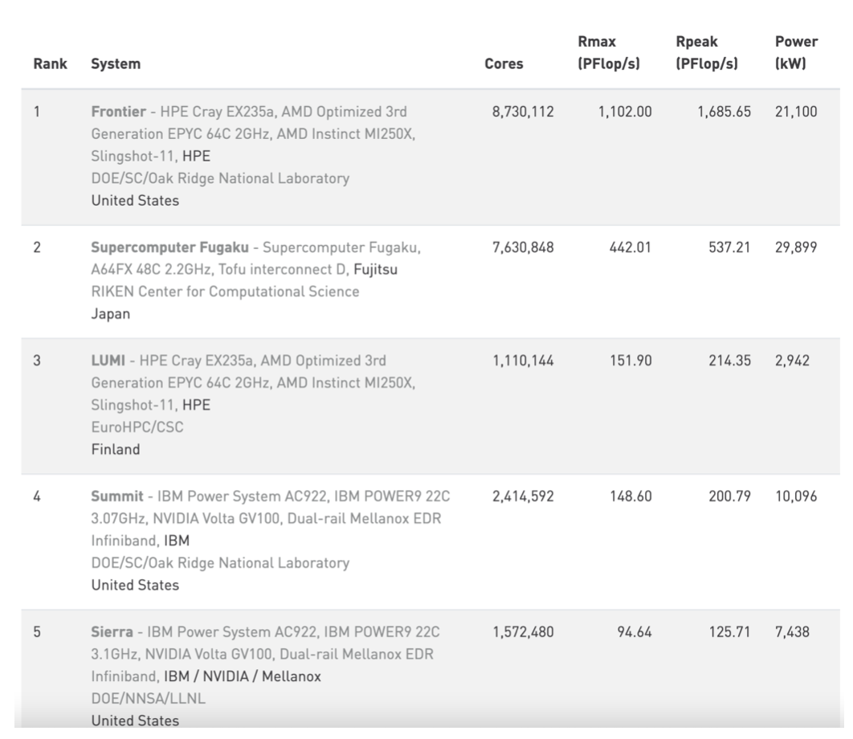
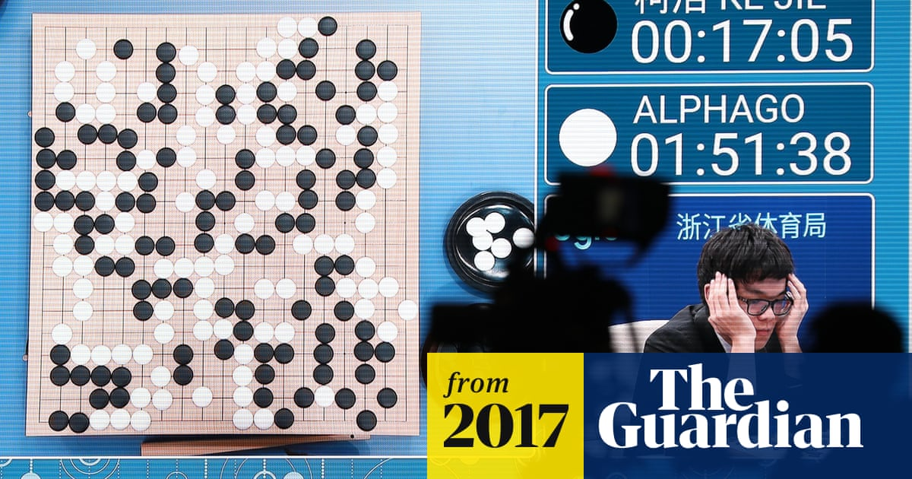
TOP500 List (June 2022)
AlphaGo
Google DeepMind
With Frontier, we could imagine 30 millions of billions moves per second (scaling from Deep Blue)
With current computing powers, AI-based applications are expected to be highly efficient
High Performance Artificial Intelligence
Seminar at Universidade Federal Fluminense (UFF- Niteroi / Brazil) – April 19, 2023

Slide 5

Real-Life Compromise
Our actions should be smarter with more time to decision
Our time to decision is always bounded and should be shorter enough to be useful
(Sport; Game; Work; Investments; Driving; …)
If you think too much before taking a step, then
you might spend the rest of your life with one leg in the air.
Chinese Proverb.
High Performance Artificial Intelligence
Seminar at Universidade Federal Fluminense (UFF- Niteroi / Brazil) – April 19, 2023

Slide 6
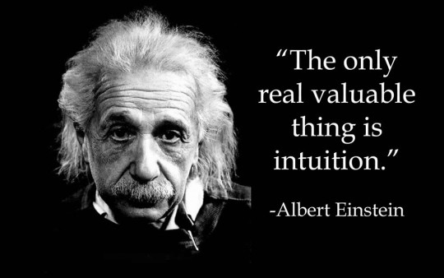
AI and Human Intelligence
The fact that AI can defeat or outperform a human does not mean ”smarter”
AI is implemented through computers, thus it runs deterministic algorithms
HUMAN | AI
Brain (memory) | Data
Brain (connections) | Machine
Brain (memory + connections) | Algorithm
Intuition | -
Random | Pseudo-random
Emotion | -
AI needs know-how (by design or through learning), while Human might invent (originality)
With the increasingly powerful HPC support to AI, the Turing Test might become harder
AI is made and driven by humans, could we thus imagine it going beyond ?
High Performance Artificial Intelligence
Seminar at Universidade Federal Fluminense (UFF- Niteroi / Brazil) – April 19, 2023

Slide 7



High Performance AI Applications
ECONOMY/FINANCE/BANKING
Customer Service (build deep and personal relationships with customers)
Security and Fraud Detection (detect fraudulent activities seen as abnormal behaviours)
Mobile Banking (with AI-based only interaction, online banking can offer a round-the-clock service
Algorithmic Trading and Risk Management (large-scale prediction and decision making)
(outcome, probability)
(outcome, probability)
.
.
.
(outcome, probability)
DECISION
Chatbots and Other Bots (ubiquity while keeping close to human touch)
52% of financial services industry are investing in AI
72% of business decision makers believe that AI will be the business advantage of the future
According to research conducted by Autonomous Next
« the aggregate potential cost savings for banks from AI applications
is estimated at $447 billion by 2023 »
https://www.ciol.com/artificial-intelligence-every-bank-needs/
High Performance Artificial Intelligence
Seminar at Universidade Federal Fluminense (UFF- Niteroi / Brazil) – April 19, 2023

Slide 8
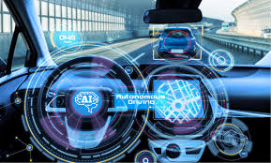
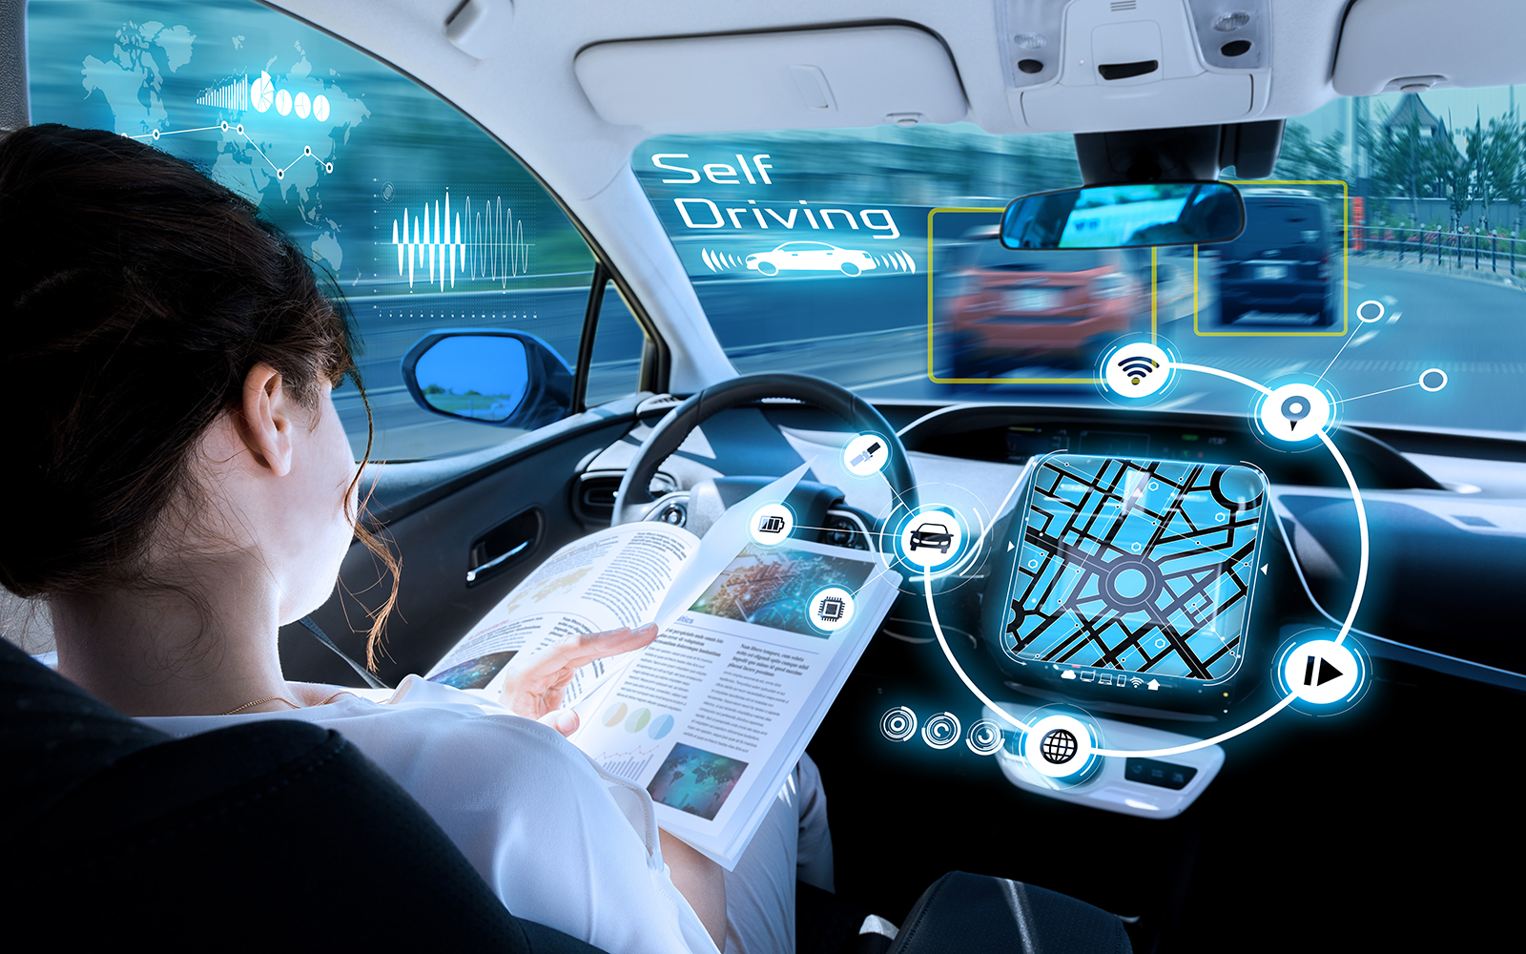



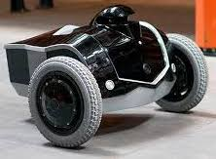

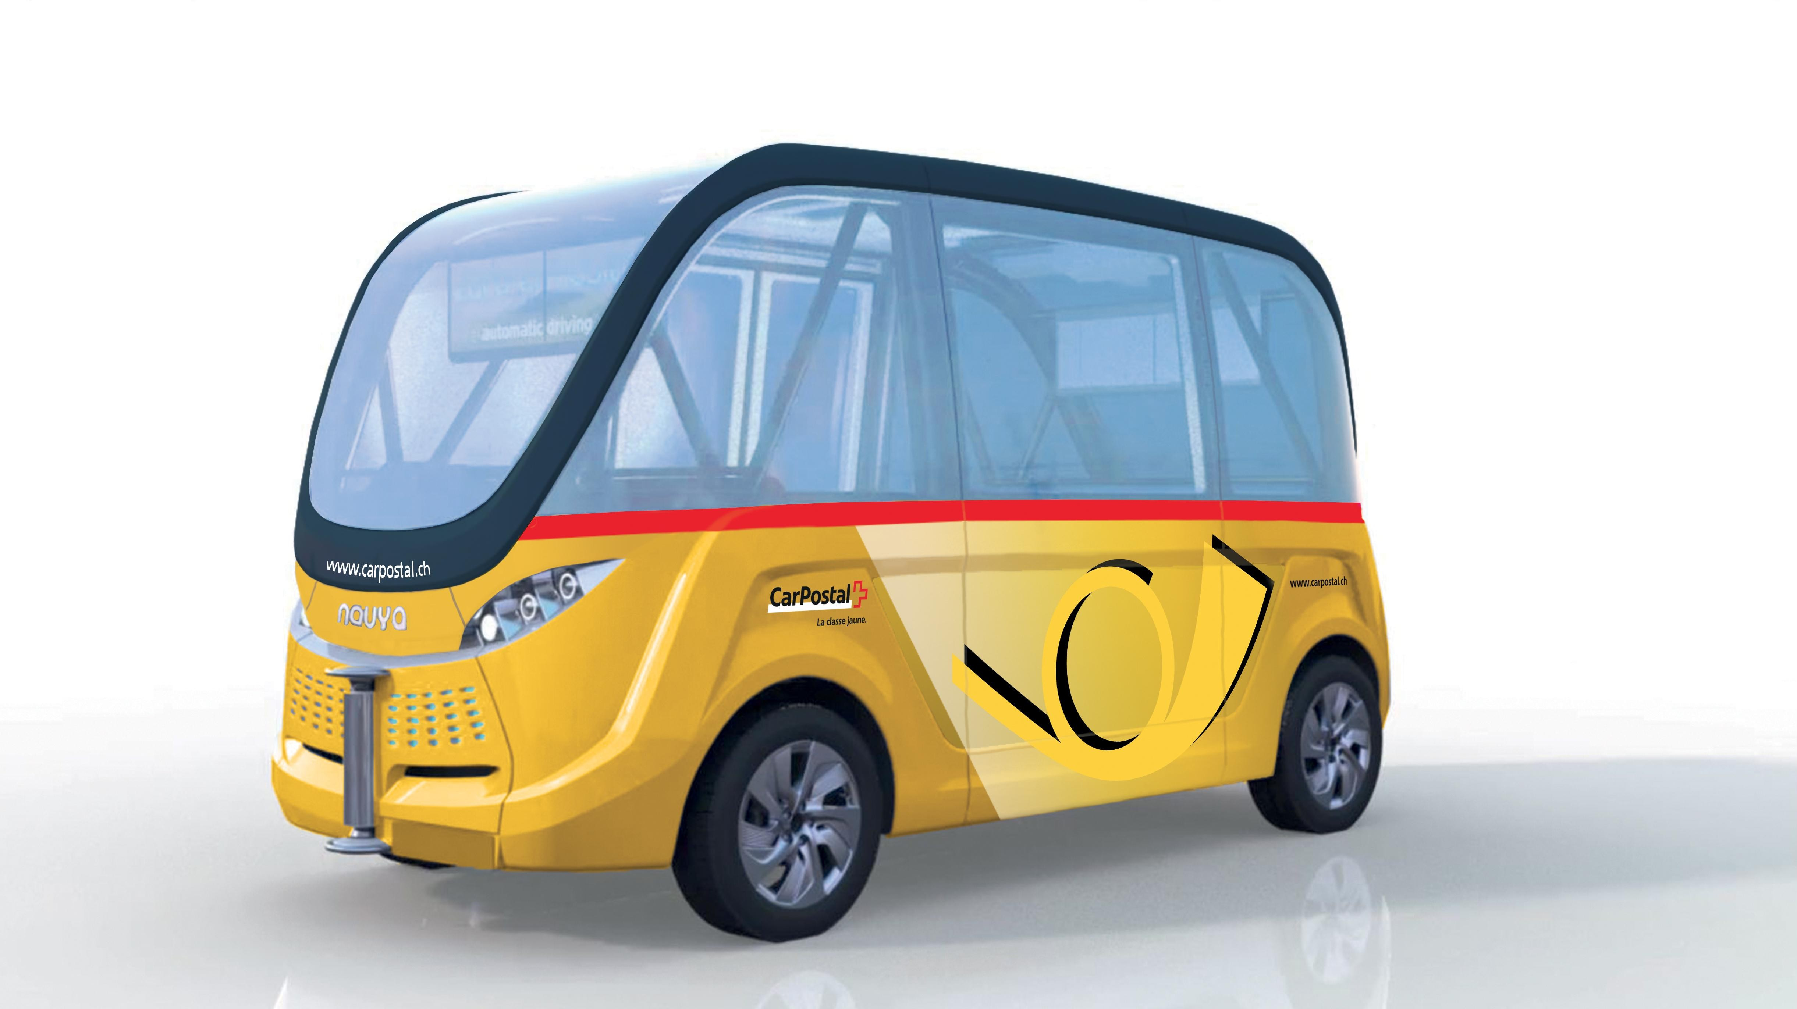
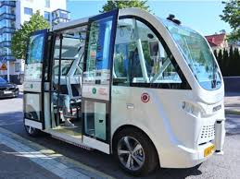
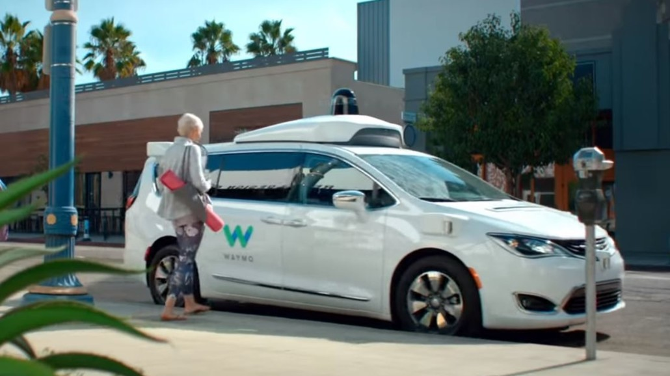
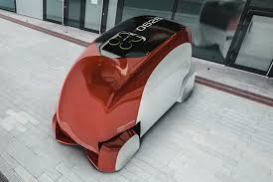
High Performance AI Applications
MONITORING
Sensing Identification + Algorithm Decision / Action
Autonomous Driving (get the driving process managed by IA)
Autonomous Surveillance (get the surveillance process managed by IA)
Autonomous Security Vehicle
Autonomous Surveillance Robot
Autonomous Security Boat
Autonomous Transportation (get the process process managed by IA)
Autonomous Aircraft (Embraer)
Autonomous Shuttle
Autonomous Bus
Autonomous Taxi
Autonomous Ambulance
High Performance Artificial Intelligence
Seminar at Universidade Federal Fluminense (UFF- Niteroi / Brazil) – April 19, 2023

Slide 9


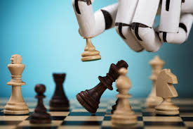



High Performance AI Applications
GAMING
AI is now pervasive in gaming (as a full machine player or as a human player assistant)
Gaming is getting more and more realistic (video games are getting smarter and more creative )
With high-precision design, AI-based gaming can even be used for general purpose assistance (disabled people, specialized education, patients daily assistance, …)
AI-based games can adapt from the player behaviour and records (the interaction thus becomes incremental and more consistent)
Coupled with virtual or augmented reality, AI-based games close the gap between pure fiction and reality (the gamer might feel that he is having a real-life experience)
High Performance Artificial Intelligence
Seminar at Universidade Federal Fluminense (UFF- Niteroi / Brazil) – April 19, 2023

Slide 10
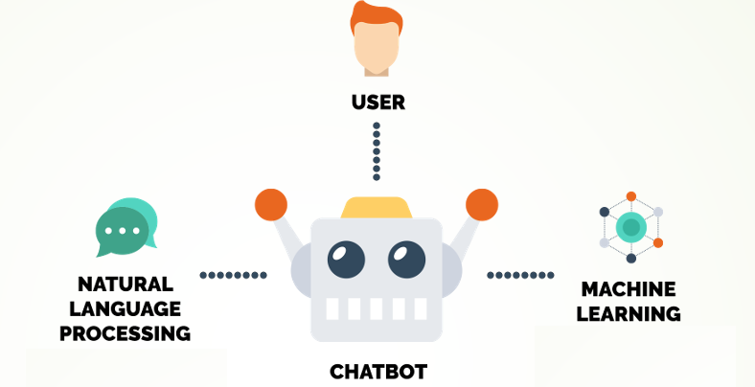
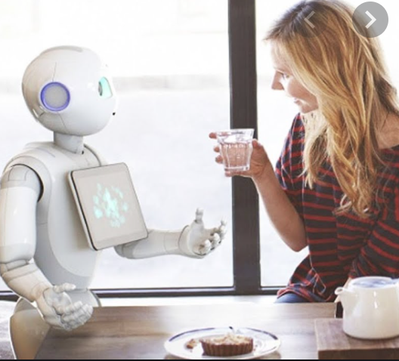
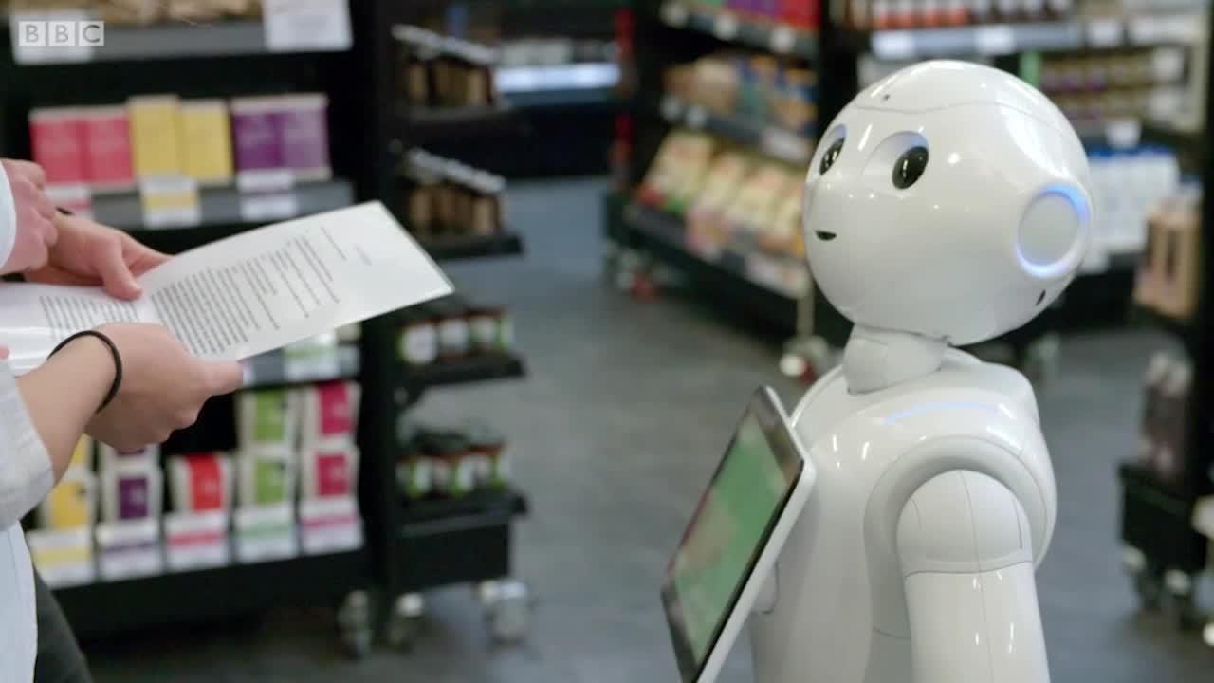



High Performance AI Applications
INTERACTION & SERVICES
Customer Service/support with AI Chatbots (expected to be real-time and realistic)
Domestic robot
Shopbot
Emotional AI (emotion is an important user input that needs to be identified and taken into account)
This emotion can be sensed through
Facial expression
Voice intonation
Language characteristic
Specific behavior
My God ,
My God !
Customized Elements (answers/suggestions/adverts/…. The user feels understood and well guided)
High Performance Artificial Intelligence
Seminar at Universidade Federal Fluminense (UFF- Niteroi / Brazil) – April 19, 2023

Slide 11



AI challenges and the Need for HPC
The quality of AI approaches goes with complex algorithms
AI
Getting good AI results might require considering lot of data
The conjunction of complex algorithms and lot of data heavy computing workload
A good AI should be real-time
Large-scale machine learning should be robust and efficient in order to scale AI
Lot of (various) data
Data-sensitive (even numerically)
Complex evaluation procedure
Repetitive learning process
Neurodegenerative diseases identified using HPC Artificial Intelligence
Mount Sinai Hospital – SC19 Award
High Performance Artificial Intelligence
Seminar at Universidade Federal Fluminense (UFF- Niteroi / Brazil) – April 19, 2023

Slide 12
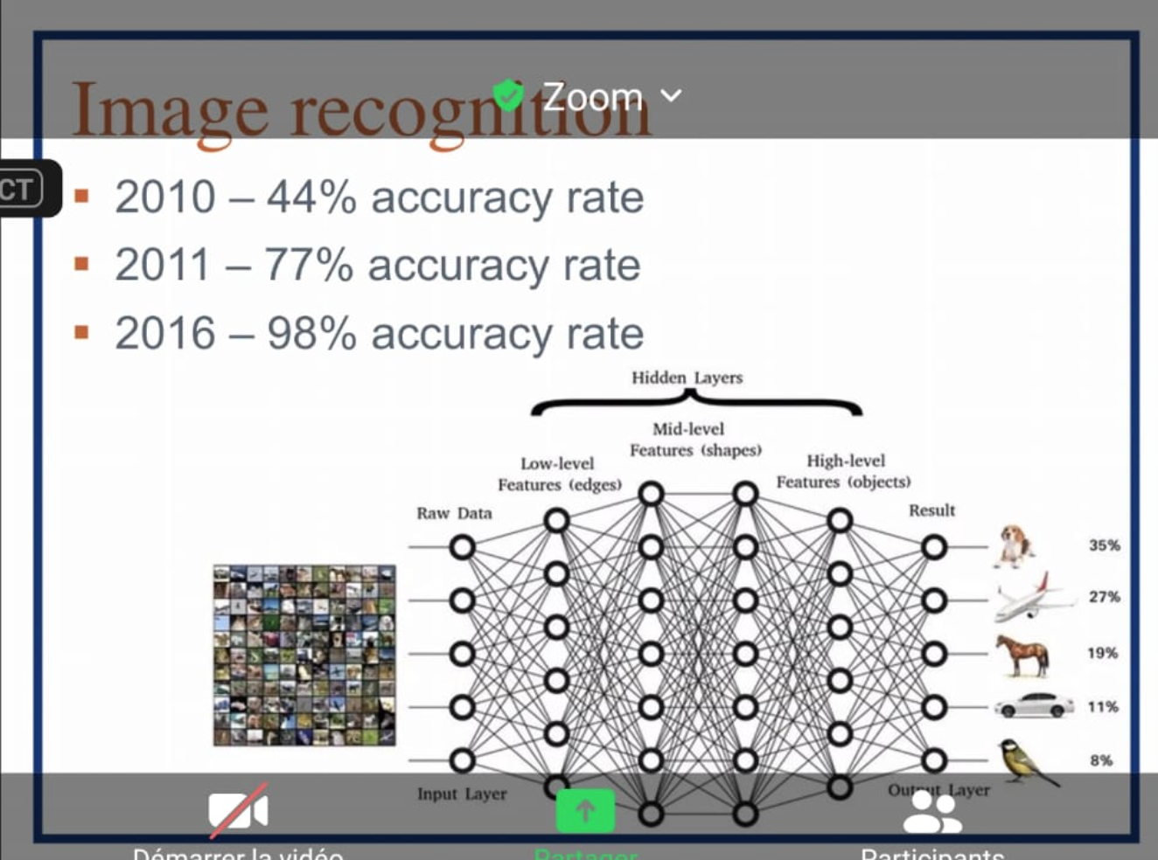

Fundamental HPC-AI Questions
With the HPC advances, should we
consider more powerful methods (likely to yield better quality solution by design) or
scale-up the scenario of those already considered (more data, more training, …)
For ordinary AI applications, how to deal with large-scale HPC infrastructures ?
(for embedded solutions, remote computation might be the better way to go)
Under the influence of HPC, should we pursue the human brain target ?
How does the (new) practical horizon of AI looks like with HPC advances consideration ?
What are the specificities of AI applications w.r.t scalable HPC ?
What about the collateral damage of HPC issues on high-performance AI ?
AI
High Performance Artificial Intelligence
Seminar at Universidade Federal Fluminense (UFF- Niteroi / Brazil) – April 19, 2023

Slide 13
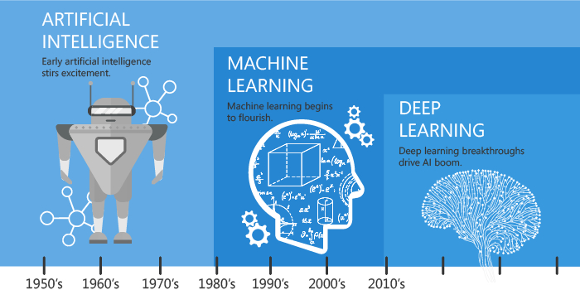
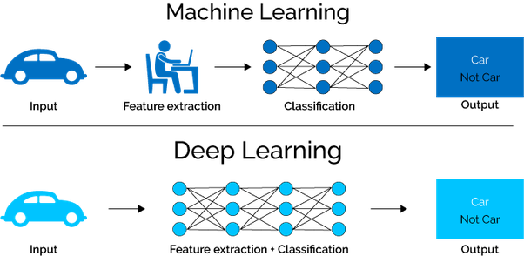
AI Methods and HPC
The most popular AI approach is Machine Learning, which has led to Deep Learning
https://hackernoon.com/
difference-between-artificial-intelligence-machine-learning-and-deep-learning-1pcv3zeg
https://blog.dataiku.com/ai-vs.-machine-learning-vs.-deep-learning
Since AI leads to a decision process, it uses (complex) Operational Research algorithms
HPC impact on AI algorithms will mainly come from the impact on OR advances
HPC devices that are tailored for Deep Learning are being considered
HPC libraries for AI is a valuable software step
AI will also impact HPC techniques (compilation, deployment, scheduling, …)
High Performance Artificial Intelligence
Seminar at Universidade Federal Fluminense (UFF- Niteroi / Brazil) – April 19, 2023

Slide 14
AI Methods and HPC
Heuristic
We are not always so dependent on having an exact or optimal solution and the
time to get one might be so long that it won’t be worth considering it anymore.
Verywell / Cindy Chung
We have to decide quickly (HPC itself might not be sufficient!)
The path to the right decision my tolerate some deviation/simplification/omission
Exact/optimal algorithms might be unscalable (thus inefficient with large-scale HPC)
HPC implementations of heuristic algorithms need to be scalable enough
High Performance Artificial Intelligence
Seminar at Universidade Federal Fluminense (UFF- Niteroi / Brazil) – April 19, 2023

Slide 15
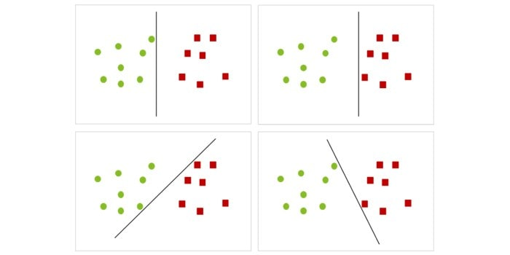
AI Methods and HPC
Support Vector Machines
Most of real-life decisions are based on a data-oriented classification that is expected
to be simple enough so has to yield a fast identification procedure.
Examples: A given email is a spam or not ? A given bank transaction is suspicious or not ?
https://www2.deloitte.com/nl/nl/pages/data-analytics/articles/part-2-artificial-intelligence-techniques-explained.html
Data intensive (might be highly multi-dimensional)
Numerically sensitive (robust numerical method might be considered)
A good quality separator might be more complex than desired (thus a HPC challenge)
High Performance Artificial Intelligence
Seminar at Universidade Federal Fluminense (UFF- Niteroi / Brazil) – April 19, 2023

Slide 16
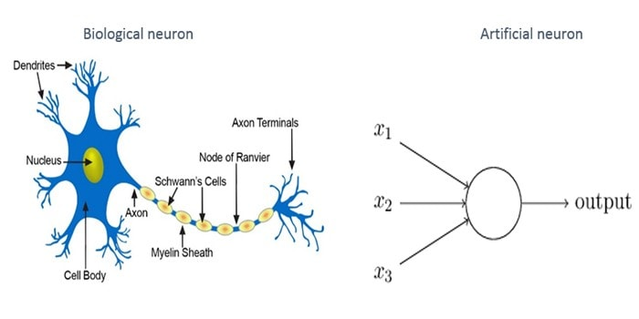
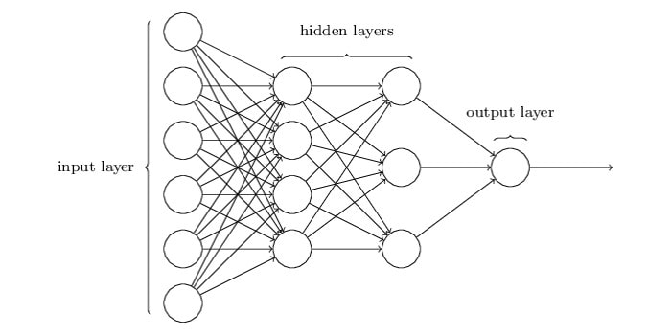
AI Methods and HPC
Artificial Neural Networks
Artificial Neural Networks (ANN) is a major paradigm used in AI. ANN has a few neurons
while human brain has hundred billions.
https://www2.deloitte.com/nl/nl/pages/data-analytics/articles/part-2-artificial-intelligence-techniques-explained.html
Typical applications: Image Recognition (CNN) and and Speech Recognition (RNN)
Large-scale ANN faces the difficulty of maintain both efficiency and accuracy
A large volume of data might come with redundancy
Scalability is also challenging, especially with distributed memory parallelism (communications)
High Performance Artificial Intelligence
Seminar at Universidade Federal Fluminense (UFF- Niteroi / Brazil) – April 19, 2023

Slide 17
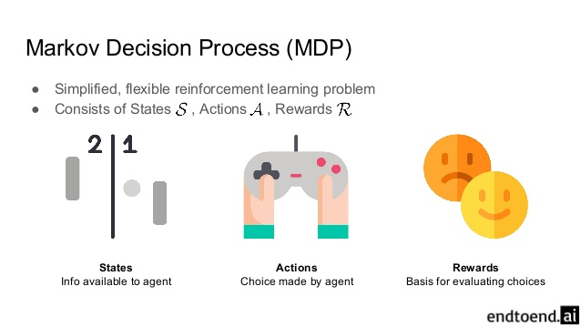
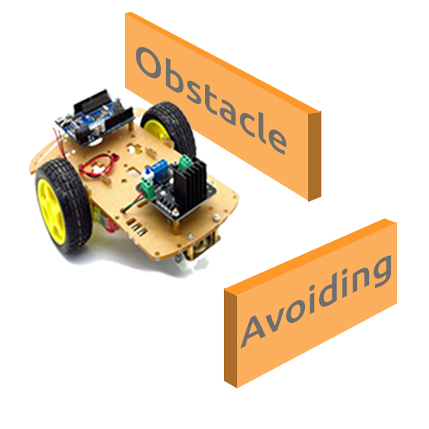
AI Methods and HPC
Markow Decision Process
Markov Decision Process (MPD) is another paradigm used in AI. MDP is appropriate for
modelling a stepwise process under specific transition hypotheses.
Typical applications: Path Monitoring, Inventory Management, Gaming
MDP might be coupled with a ML algorithm (e.g. Obstacle Avoiding Robots)
MDP has a strong linear (and Kronecker) algebra that is HPC challenging
Numerical issues (iterative process) and scalability issues (multi-dimensional cases)
High Performance Artificial Intelligence
Seminar at Universidade Federal Fluminense (UFF- Niteroi / Brazil) – April 19, 2023

Slide 18
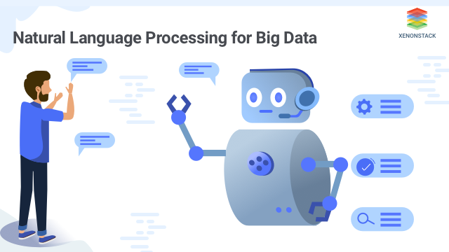
AI Methods and HPC
Natural Language Processing
Natural Language Processing (NLP) is an important topic in AI, covering techniques
for Natural Language Understanding (NLU) and Natural Language Generation (NLG).
NLU
Lexical Ambiguity
Syntactic Ambiguity
Semantic Ambiguity
Anaphoric Ambiguity
NLG
Text Planning
Sentence Planning
Realization
Typical applications: Chatbots, Log Analysis, Log Mining, Identification
Ambiguity leads to a highly combinatorial process for NLP
NLP can be coupled with ML and might involved a large volume of data
Like any combinatorial algorithm, HPC efficiency and scalability are not trivial
High Performance Artificial Intelligence
Seminar at Universidade Federal Fluminense (UFF- Niteroi / Brazil) – April 19, 2023

Slide 19
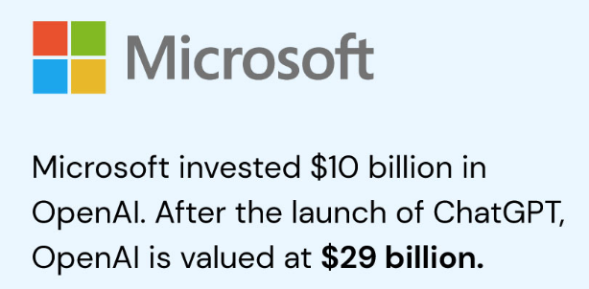
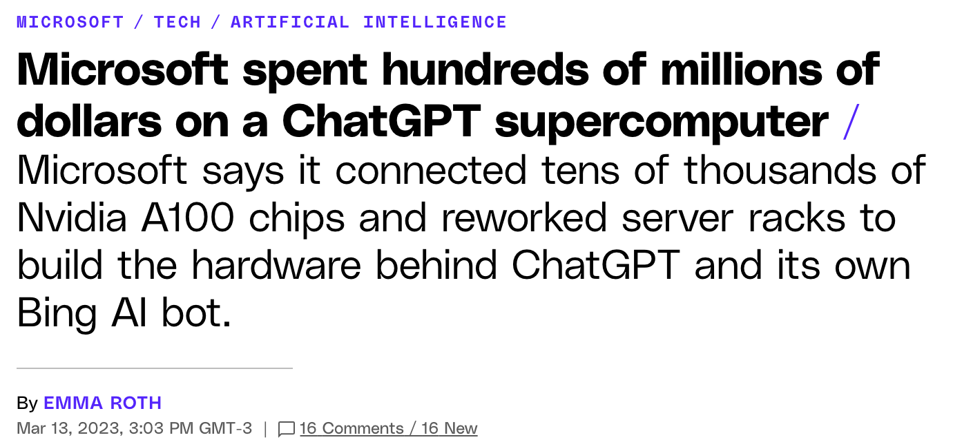
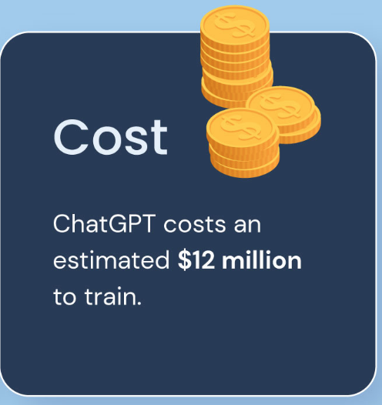


ChatGPT statistics related the need for HPC
It has 175 billion parameters and receives 10 millions queries per day.
It was trained on a massive corpus of text data, around 570GB of datasets.
The response time of ChatGPT is typically less than a second (real-time conversations).
ChatGPT has been integrated into a variety of platforms and applications.
One of the biggest challenges is its computational requirements.
The monthly cost of running ChatGPT is estimated to be around $3 million.
High Performance Artificial Intelligence
Seminar at Universidade Federal Fluminense (UFF- Niteroi / Brazil) – April 19, 2023

Slide 20
Conclusion
HPC advances tend to scale-up the expectations with AI
Cutting-edge AI need to remain real-time, thus the strong need for HPC
Connecting AI techniques might lead to heterogeneous HPC implementation
AI-specialized HPC devices will be a central component for routine AI support
As HPC is moving towards ambitious horizons, High Performance AI will follow similarly
HPC ←→ AI will raise interesting fundamental/philosophical questions
High Performance Artificial Intelligence
Seminar at Universidade Federal Fluminense (UFF- Niteroi / Brazil) – April 19, 2023

Slide 21
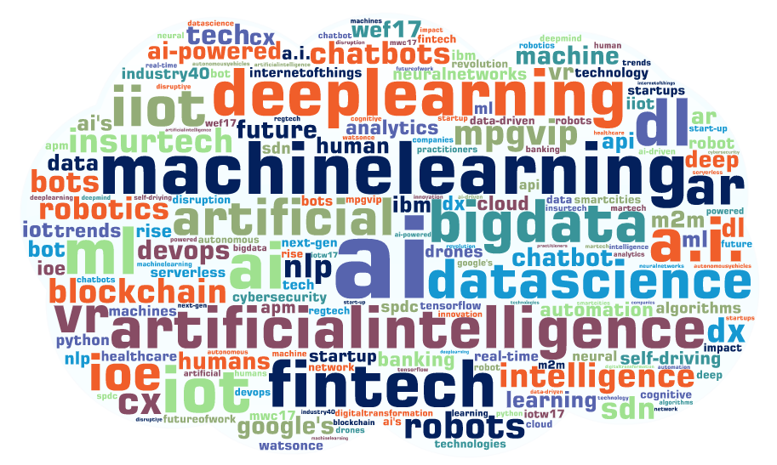
END – QUESTIONS ?
High Performance Artificial Intelligence
Seminar at Universidade Federal Fluminense (UFF- Niteroi / Brazil) – April 19, 2023

