Slide 1


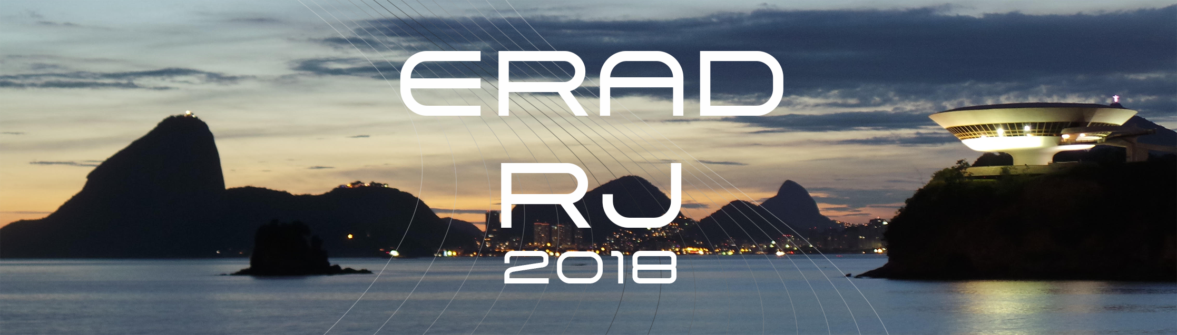
HPC Reality through Case Studies
Claude TADONKI
Centre de Recherche en Informatique (CRI)
Mines ParisTech - PSL
IV Escola Regional de Alto Desempenho Rio de Janeiro (ERAD-RJ 2018)
May 09-11, 2018, NITEROI - BRAZIL

Slide 2
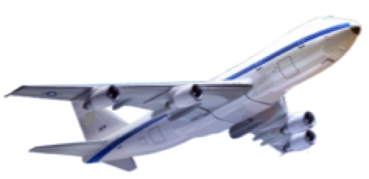


Let’s Feel the HPC Reality
Another direction
and slower!
Another direction
and slower!
Less than 1 hour at at cruising speed !
844 km
Curitiba
Rio de Janeiro
Santos Dumont
Taxi
Traffic Jam!
Sambódromo
Claude TADONKI
MINES ParisTech - PSL
HPC Technical Challenges
ERAD Rio de Janeiro – May 09, 2018 - NITEROI - BRAZIL

Slide 3

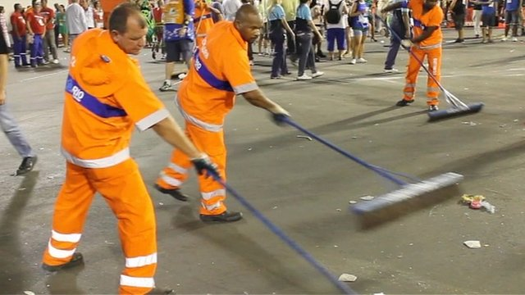


Let’s Feel the HPC Reality
I could get this on arrival there !!!!
What is fast is the existing means,
but the case in practice is likely to be far from expectations.
That's HPC
Claude TADONKI
MINES ParisTech - PSL
HPC Technical Challenges
ERAD Rio de Janeiro – May 09, 2018 - NITEROI - BRAZIL

Slide 4
Let’s Feel the HPC Reality
Another direction
and slower!
Another direction
and slower!
Less than 1 hour at at cruising speed !
844 km
1h30
Curitiba
Rio de Janeiro
Santos Dumont
30 mn
Taxi
Traffic Jam!
Sambódromo
50%
Efficiency!
I finally get there after at least 2 hours !!!!!!!!
Claude TADONKI
MINES ParisTech - PSL
HPC Technical Challenges
ERAD Rio de Janeiro – May 09, 2018 - NITEROI - BRAZIL

Slide 5
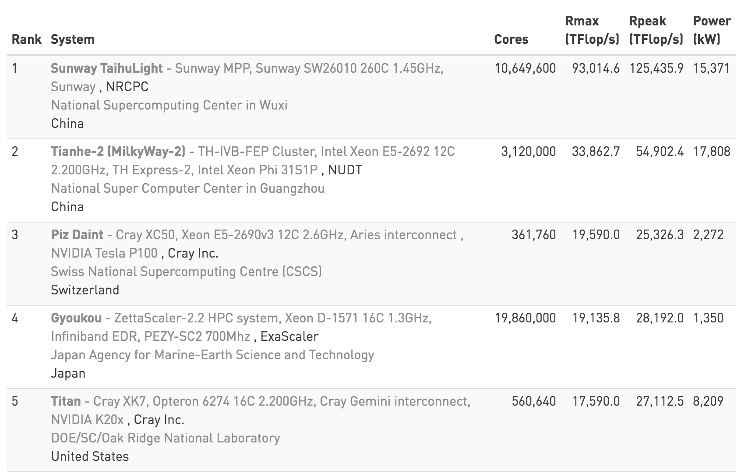
Fastest Supercomputers
Top500 List in November 2017
We stand at 10% of the Exascale, which is now expected from 2020 !
Claude TADONKI
MINES ParisTech - PSL
HPC Technical Challenges
ERAD Rio de Janeiro – May 09, 2018 - NITEROI - BRAZIL

Slide 6
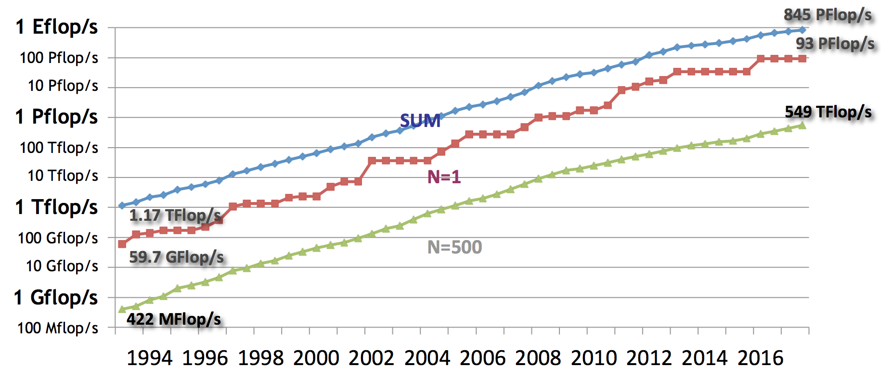
Evolution of the Computing Power
Evolution of the computing power since 1993
www.top500.org
The current top one is 256 000 times faster than the top on in 1993 !!!
Claude TADONKI
MINES ParisTech - PSL
HPC Technical Challenges
ERAD Rio de Janeiro – May 09, 2018 - NITEROI - BRAZIL

Slide 7
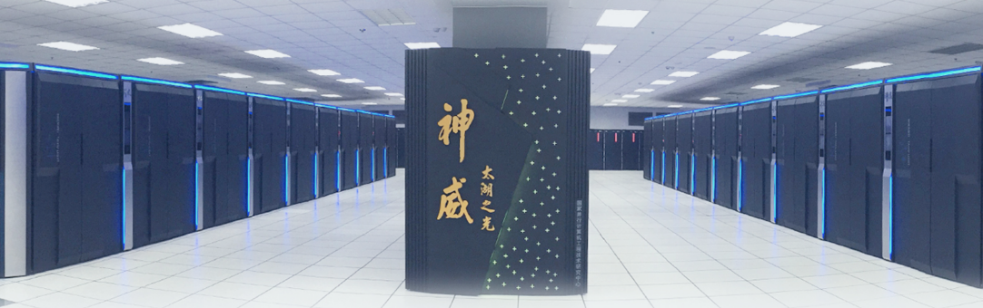
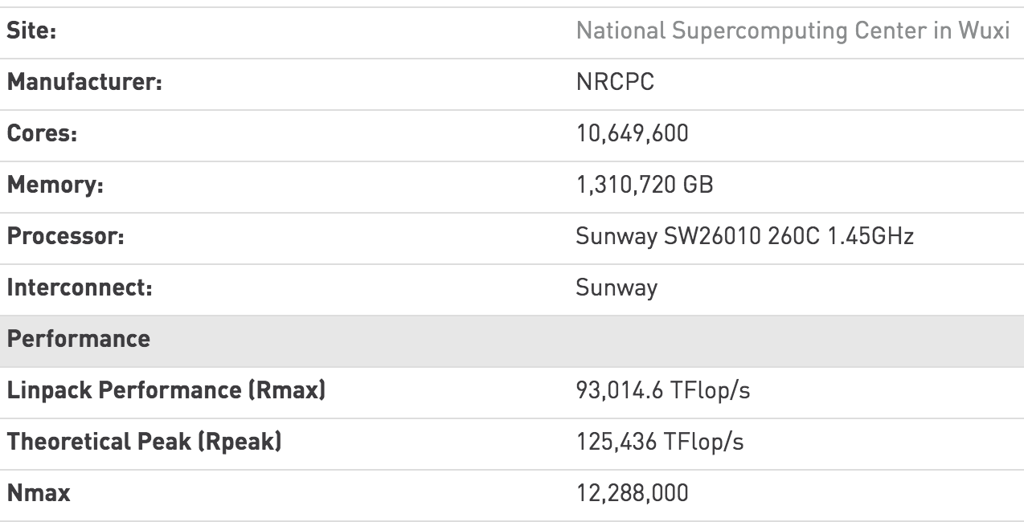
Fastest Supercomputers
Sunway TaihuLight Supercomputer – World fastest
Each node is a 256-core processor
Claude TADONKI
MINES ParisTech - PSL
HPC Technical Challenges
ERAD Rio de Janeiro – May 09, 2018 - NITEROI - BRAZIL

Slide 8
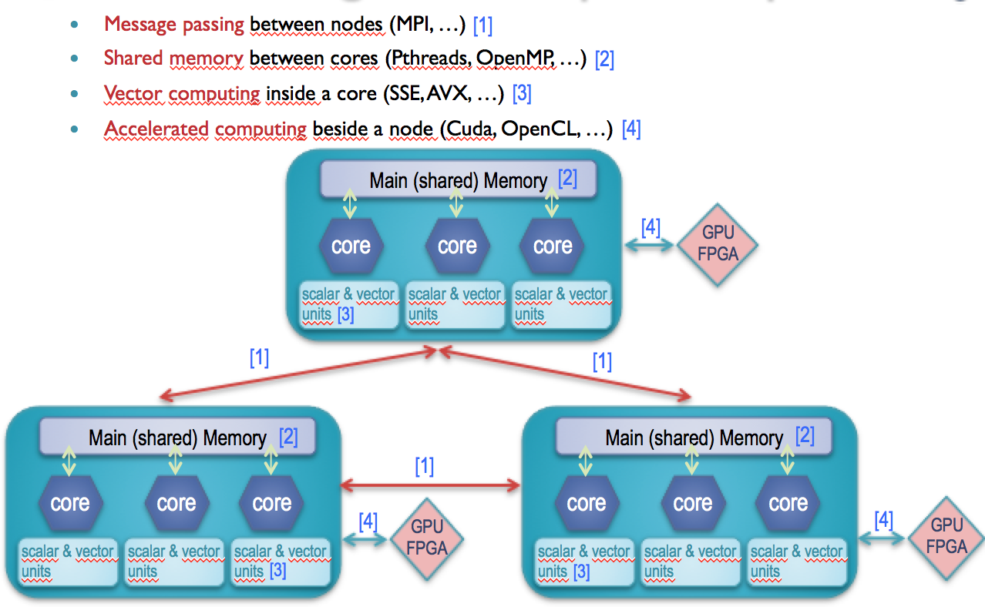
Implementing on a Supercomputer
Claude TADONKI
MINES ParisTech - PSL
HPC Technical Challenges
ERAD Rio de Janeiro – May 09, 2018 - NITEROI - BRAZIL

Slide 9
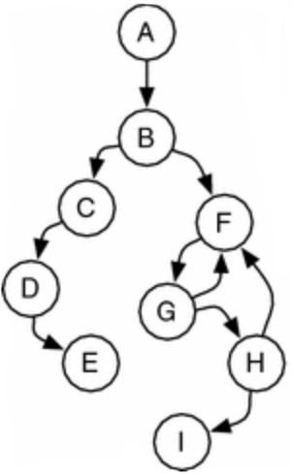


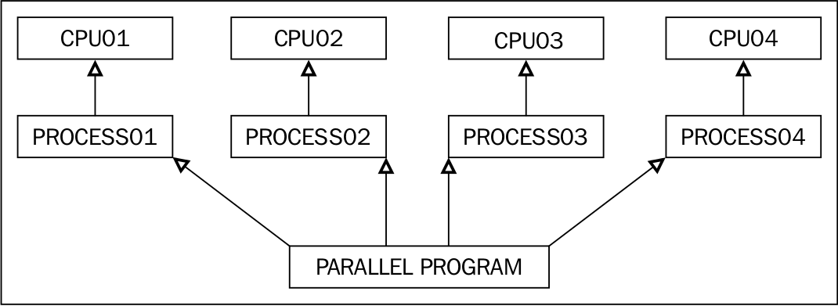
Steps from Thought to Supercomputing
Paradigm
Ad-Hoc
Effort is here
Paradigm
Parallelizer
Ad-Hoc
Prog Model
Ad-Hoc
Tools & Lib
ALGORITHM
PARALLEL ALGORITHM
PARALLEL PROGRAM
Life is here
Support tools
Debugger
Profilers
PARALLEL EXECUTION
Claude TADONKI
MINES ParisTech - PSL
HPC Technical Challenges
ERAD Rio de Janeiro – May 09, 2018 - NITEROI - BRAZIL

Slide 10

Important Facts in the Supercomputing Context
It is hard to get a significant ratio of the peak performance on common applications
Advertised performances do not count data accesses and necessary synchronizations
A good algorithm in theory might lead to an inefficient program
Sequential optimizations sometimes conflict with parallel suitability
Compute-bound and data-bound do not have the same behaviour
Some applications are strongly sequential or too irregular for good parallel speedups
The use of specialized libraries for specific kernels (kernel) requires interoperability efforts
Data layout, data type, data reuse made impossible, incompatible targets
Claude Tadonki , « High Performance Computing as a Combination of Machines and Methods and Programming »,
HDR thesis, Paris-Sud University, May 16, 2013.
Claude Tadonki , « High Performance Computing Landscape and Challenges »,
CRI MINES ParisTech Technical Report E/435/CRI , April 2018.
Claude TADONKI
MINES ParisTech - PSL
HPC Technical Challenges
ERAD Rio de Janeiro – May 09, 2018 - NITEROI - BRAZIL

Slide 11
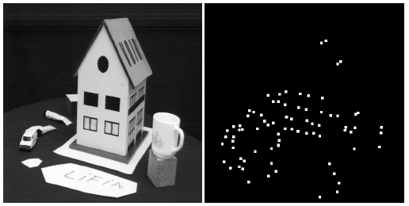
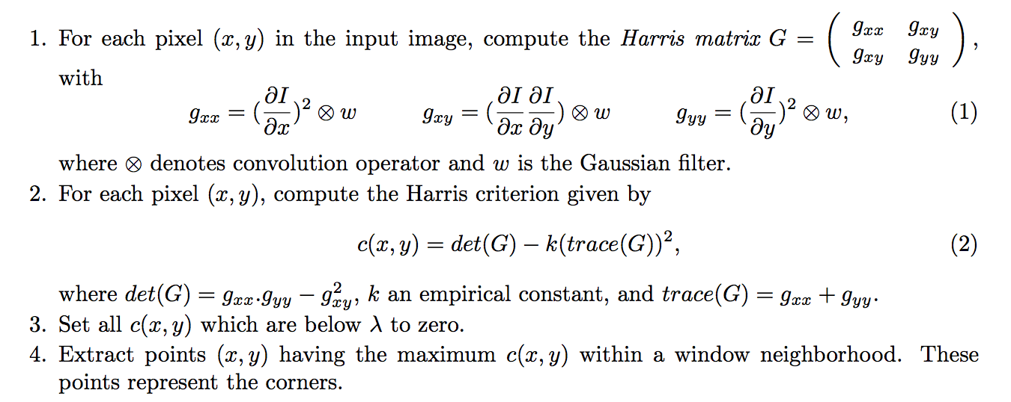
Case study: Harris Corner Detection
The Harris-Stephen algorithm is
a corner (point of interest) detection algorithm
an improved variant of the original algorithm by Moravec
used in computer vision for feature extraction like
  motion detection
  image matching
  tracking
  3D reconstruction
  object recognition
O. Haggui, C. Tadonki, L. Lacassagne, F. Sayadi, and B. Ounid, « Harris Corner Detection on a NUMA ManyCore »,
Future Generation Computer Systems, DOI: 10.1016/j.future.2018.01.048, 2018.
Claude TADONKI
MINES ParisTech - PSL
HPC Technical Challenges
ERAD Rio de Janeiro – May 09, 2018 - NITEROI - BRAZIL

Slide 12
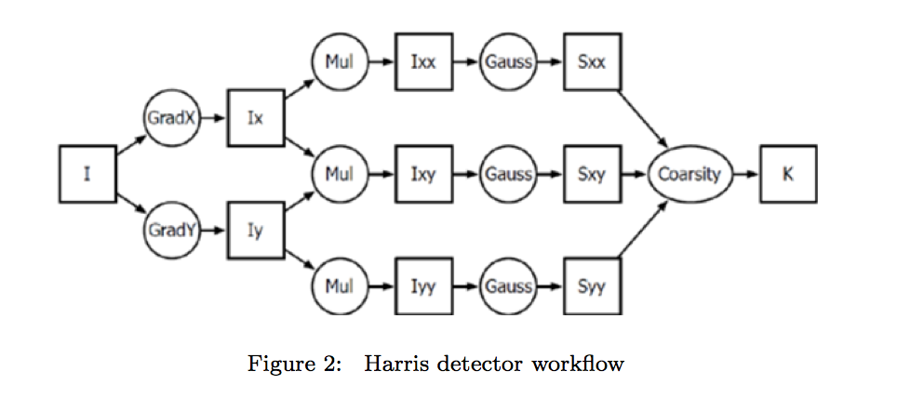
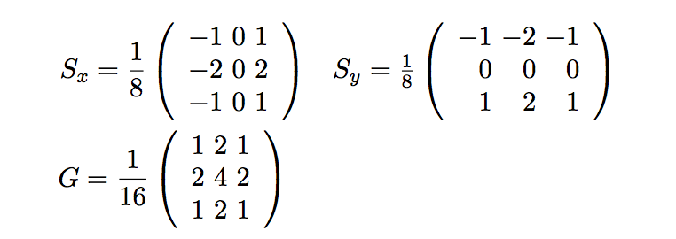
Case study: Harris Corner Detection
The procedure applies a series of convolution kernels to the input intensity matrix
Each convolution is a stencil computation
The whole computation can be fully serial, fully pilelined, or hybrid.
Memory acces patterns are the main focus w.r.t performances
Claude TADONKI
MINES ParisTech - PSL
HPC Technical Challenges
ERAD Rio de Janeiro – May 09, 2018 - NITEROI - BRAZIL

Slide 13
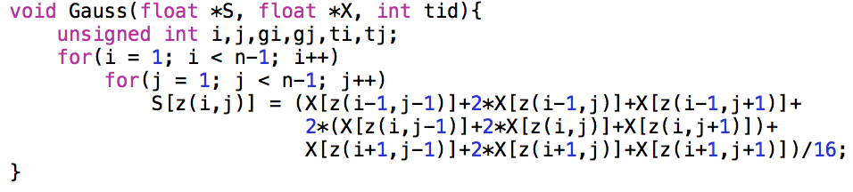
Case study: Harris Corner Detection
Stencil computation: redundant memory accesses, cache misses, and unalignement
Scheduling of the convolutions : Intermediate reads/writes (space and access time)
SIMD: not efficient in its standard form (what we get from the compiler)
SM Parallelism: bus contention, threads synchronization, NUMA
We are going to explain our approach for each of the aforementioned aspects !!!
Claude TADONKI
MINES ParisTech - PSL
HPC Technical Challenges
ERAD Rio de Janeiro – May 09, 2018 - NITEROI - BRAZIL

Slide 14
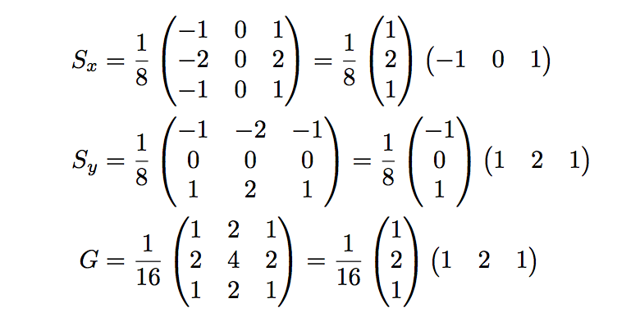
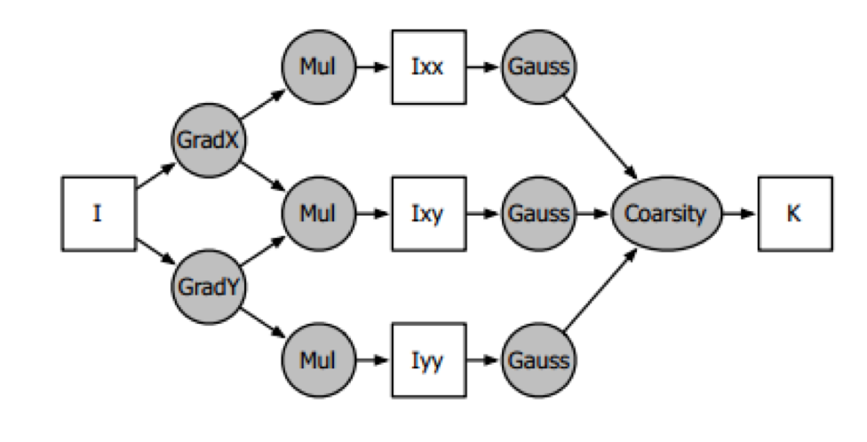
Case study: Harris Corner Detection
Separability
Half-Pipe Clustering
Claude TADONKI
MINES ParisTech - PSL
HPC Technical Challenges
ERAD Rio de Janeiro – May 09, 2018 - NITEROI - BRAZIL

Slide 15
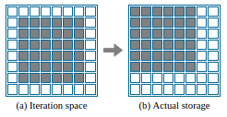
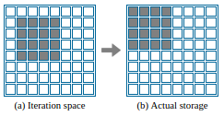

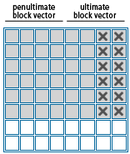
Case study: Harris Corner Detection
Vectorization with the original memory access pattern leads to unaligned accesses
We propose a diagonal shift to keep all accesses aligned
The last vector register contains 2 dirty values, but the whole vector is stored (4-components vector)
Claude TADONKI
MINES ParisTech - PSL
HPC Technical Challenges
ERAD Rio de Janeiro – May 09, 2018 - NITEROI - BRAZIL

Slide 16
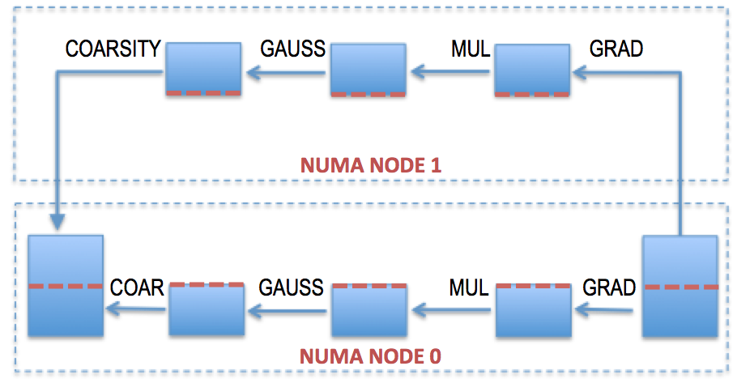
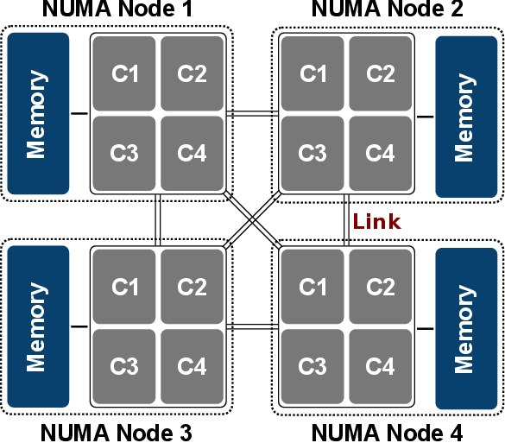
Case study: Harris Corner Detection
Both input and output images are stored on NUMA node 0
Each NUMA node locally computes its chunk (block of lines) of the final result
Within each NUMA node, the work is equally distributed by block to its threads
Expected memory allocation on the NUMA nodes is done by explicit binding routines
Claude TADONKI
MINES ParisTech - PSL
HPC Technical Challenges
ERAD Rio de Janeiro – May 09, 2018 - NITEROI - BRAZIL

Slide 17
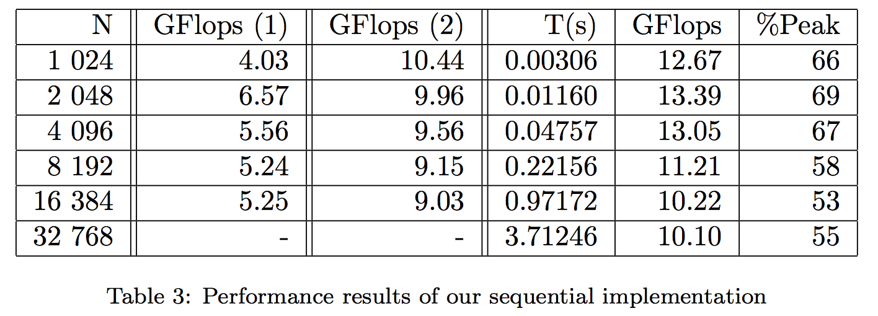
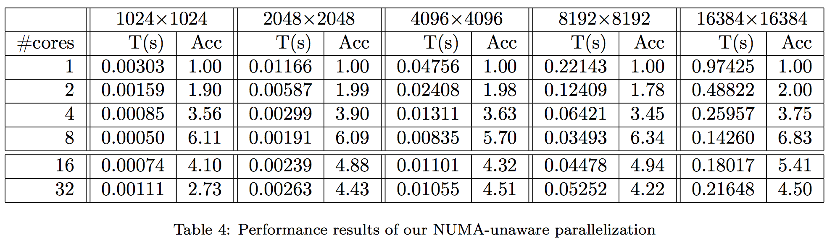
Case study: Harris Corner Detection
Claude TADONKI
MINES ParisTech - PSL
HPC Technical Challenges
ERAD Rio de Janeiro – May 09, 2018 - NITEROI - BRAZIL

Slide 18
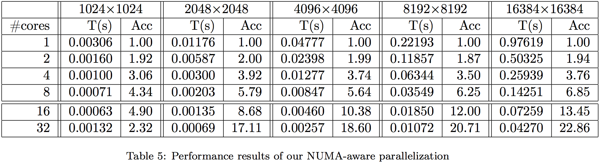
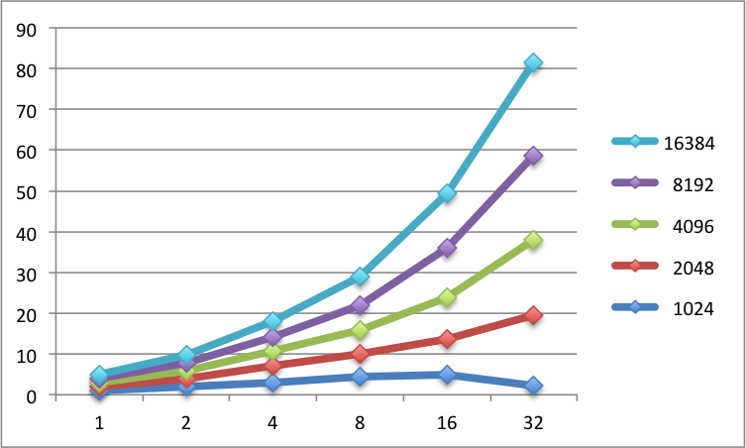
Case study: Harris Corner Detection
Claude TADONKI
MINES ParisTech - PSL
HPC Technical Challenges
ERAD Rio de Janeiro – May 09, 2018 - NITEROI - BRAZIL

Slide 19


Case Study: LQCD
Quantum ChromoDynamics (QCD) is the theory of strong interactions, whose
ambition is to explain nuclei cohesion as well as neutron and proton structure,
i.e. most of the visible matter in the Universe.
Creation of the universe (matter synthesis right after the BIG BANG) !!!
The main computational model for Quantum chromodynamics (QCD) investigations
is the so-called Lattice Quantum ChromoDynamics (LQCD).
Based on the LQCD model, (large scale) simulations are implemented !!!
In the LQCD model, the space-time is represented by a finite discrete system with
cartesian coordinates, while the interaction between subparticles is governed by
strong force theory.
LQCD provides an analytical formalism, the reference for numerical studies.
With a fixed lattice spacing, fine-grained simulations are considered through
larger lattice volume, thus increasing memory and computation complexities.
Solving the Wilson-Dirac system is the most critical computation kernel.
Claude Tadonki , « Scalable NUMA-Aware Wilson-Dirac on Supercomputers »,
International Conference on High Performance Computing & Simulation (HPCS 2017), Genoa, Italy, July 17-21, 2017.
Claude TADONKI
MINES ParisTech - PSL
HPC Technical Challenges
ERAD Rio de Janeiro – May 09, 2018 - NITEROI - BRAZIL

Slide 20

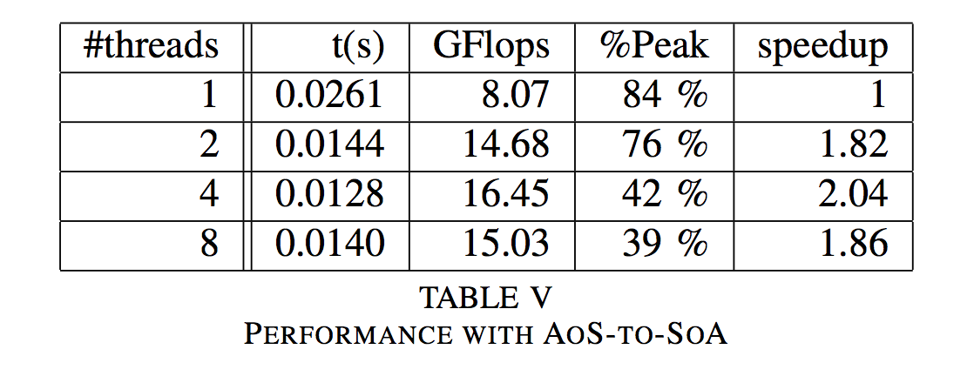
Case Study: LQCD
The Wilson-Dirac operator D on a site x (a spinor) of a quark field ψ can be defined as follows
The application of the Wilson-Dirac operator over all spinors of a quark field can be seen as a matrix-vector product, thus the name Wilson-Dirac matrix.
Large-scale LQCD
  Huge amount of data
  Non-linear access patterns
  Complex communication graph
  Full precision computation
Claude TADONKI
MINES ParisTech - PSL
HPC Technical Challenges
ERAD Rio de Janeiro – May 09, 2018 - NITEROI - BRAZIL

Slide 21

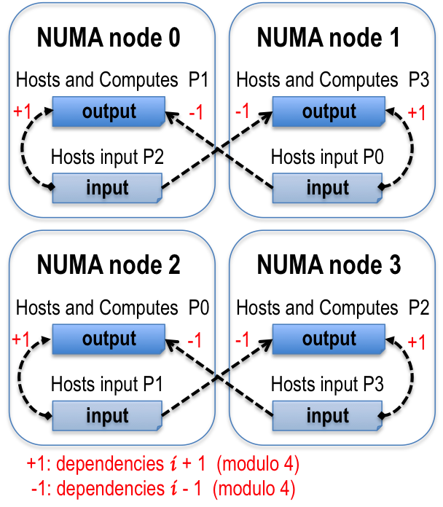


Case Study: LQCD
We extend the original even-odd partitioning
Considering the ± 1 dependence, we see that
    P₀ needs P₁ and P₃
    P₁ needs P₂ and P₀
    P₂ needs P₃ and P₁
    P₃ needs P₀ and P₂
We thus suggest the following partitioning and
allocation
Remote accesses reduced by half
and no compulsory contention
Claude TADONKI
MINES ParisTech - PSL
HPC Technical Challenges
ERAD Rio de Janeiro – May 09, 2018 - NITEROI - BRAZIL

Slide 22
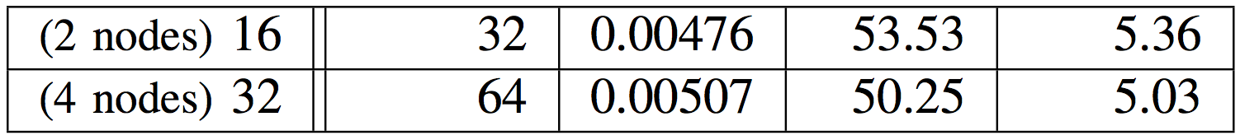

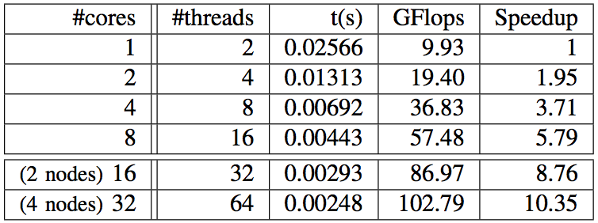

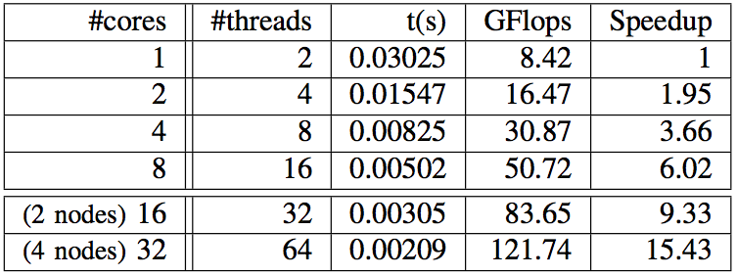

Case Study: LQCD
NUMA unaware
NUMA aware
Without
Node Splitting
NUMA aware
With
Node Splitting
Claude TADONKI
MINES ParisTech - PSL
HPC Technical Challenges
ERAD Rio de Janeiro – May 09, 2018 - NITEROI - BRAZIL

Slide 23

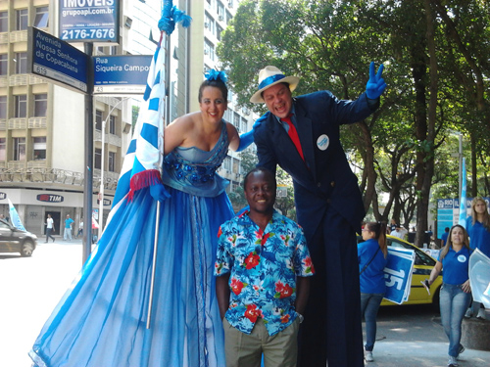

Perspectives & END
Claude TADONKI
MINES ParisTech - PSL
HPC Technical Challenges
ERAD Rio de Janeiro – May 09, 2018 - NITEROI - BRAZIL

